Slide 1
Chapter 8
pRb and Control of the Cell Cycle Clock
Nov 15, 2023
Notes:
本章主要内容：RB和细胞周期调控机制；

Slide 2
Outline of this lecture
1, Cell cycle checkpoints and cancer;
2, Basic mechanisms of cell cycle;
Cyclin+CDK
CDK inhibitor
3, RB-E2F in restriction checkpoint regulation and cancer;
Notes:
本章内容比较杂,大概分为三个部分

Slide 3
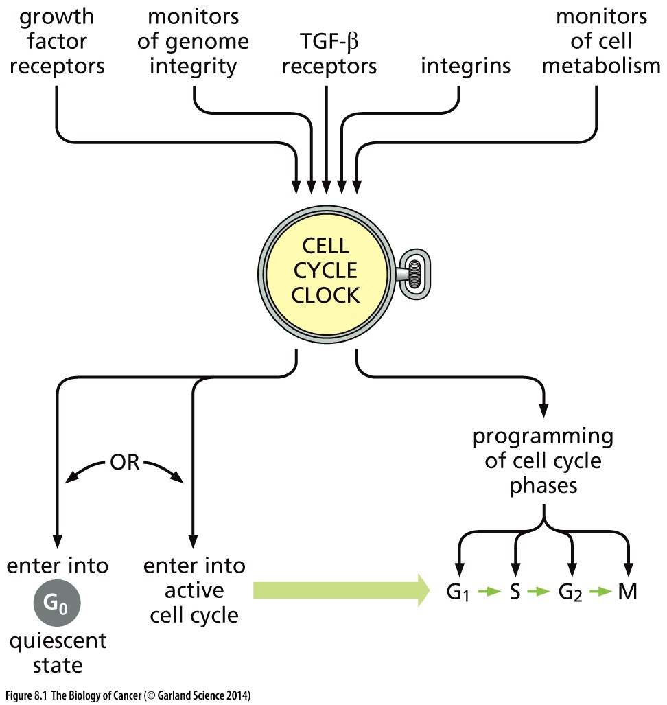
Figure 8.1 The central governor of growth and proliferation
The term “cell cycle clock” denotes a molecular circuitry operating in the cell nucleus that processes and integrates a variety of afferent (incoming) signals originating from outside and inside the cell and decides whether or not the cell should enter into the active cell cycle or retreat into a non proliferating state. In the event that active proliferation is decided upon, this circuitry proceeds to program the complex sequence of biochemical changes in a cell that enable it to double its contents and to divide into two daughter cells.
Notes:
细胞周期控制系统是细胞的核心控制系统，外界环境因素如何影响细胞周期也是今天课程的核心内容

Slide 4
8.1 Cell growth and division is coordinated by a complex array of regulators
Notes:
细胞生长 和 细胞增殖 的区别 联系

Slide 5
Cell growth versus cell division
This accumulation of cellular constituents, which drives an increase in cell size, is sometimes termed the process of cell growth to distinguish it from the process of cell division, which yields, via mitosis and cytokinesis, two daughter cells from a mother cell (Figure 8.2).

Slide 6
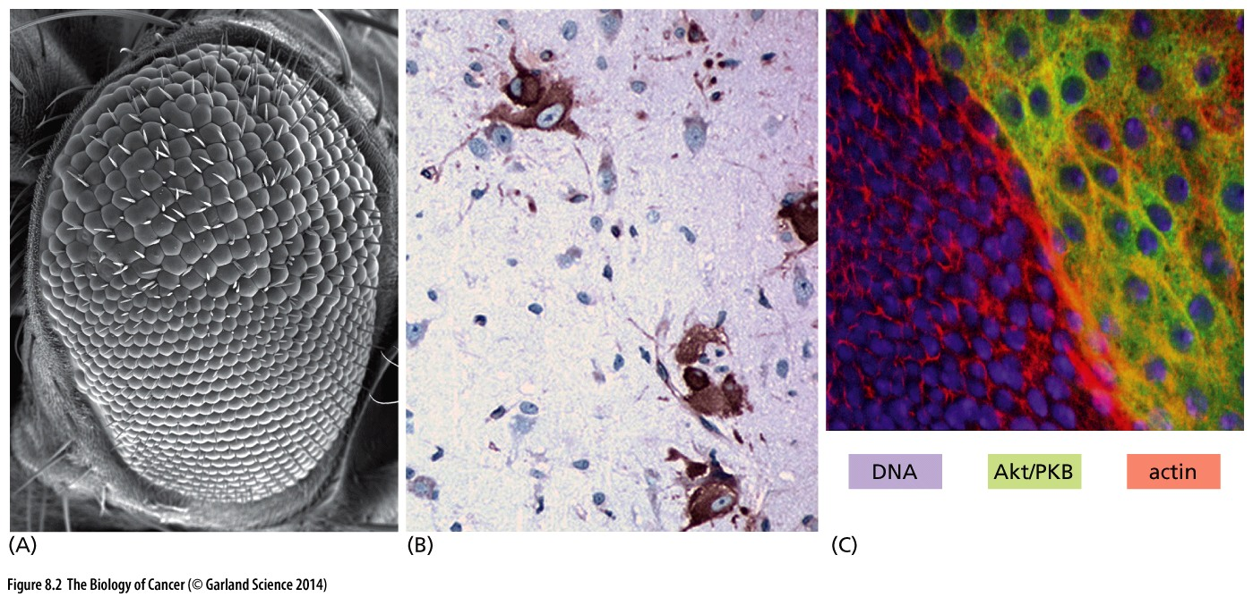
Figure 8.2 Growth versus proliferation
Alterations of certain signaling proteins, such as the one encoded by the TSC1 tumor
suppressor gene, allow the processes of cell growth and division to be uncoupled from one another.
Notes:
In most cases, cell growth will leads to cell proliferation, but in occasion…

Slide 7
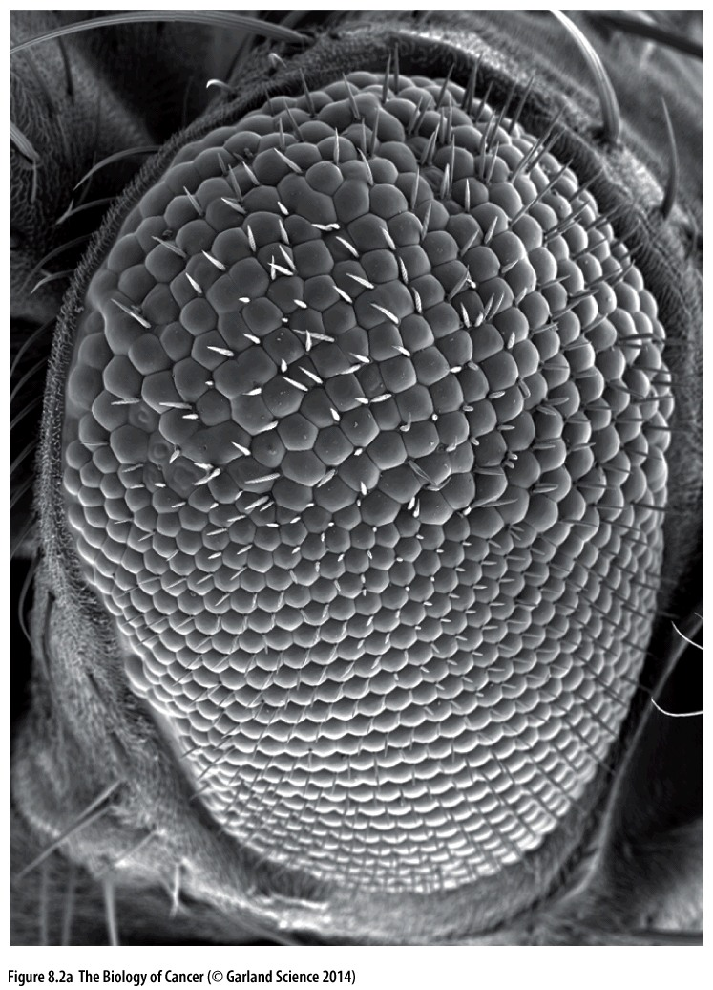
Figure 8.2 Growth versus proliferation
In this scanning electron micrograph of a Drosophila eye, the ommatidial(小眼) cells in the upper portion of the eye have been deprived of the fly ortholog of TSC1; these cells are physically larger than the wild-type cells shown (below), because they have grown more during the cell cycles that led to their formation.
Notes:
AKT---TSC---mTOR---pS6 信号特异参与细胞生长调控

Slide 8
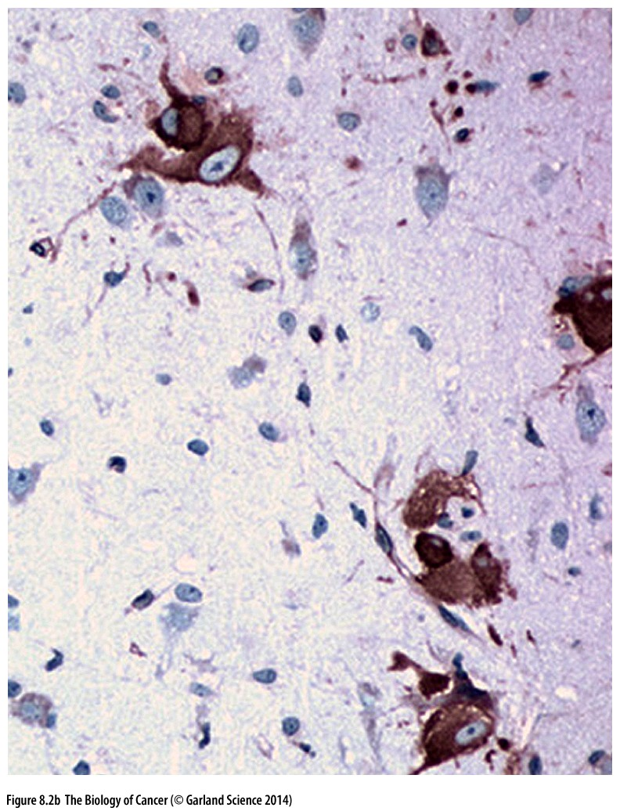
Figure 8.2 Growth versus proliferation
The same behavior can be seen in the brains of patients suffering from tuberous sclerosis(结节性硬化), in which TSC1 function has been lost through a germ-line mutation and subsequent somatic loss of heterozygosity. Seen here are the giant cells present in a benign growth (a “tuber”). The giant cells (brown) are labeled with an antibody against phosphorylated S6, a ribosomal protein important in regulating protein synthesis and thus cell growth; S6 phosphorylation and functional activation is deregulated in cells lacking TSC1 function.
Notes:
AKT---TSC---mTOR---pS6 信号特异参与细胞生长调控

Slide 9
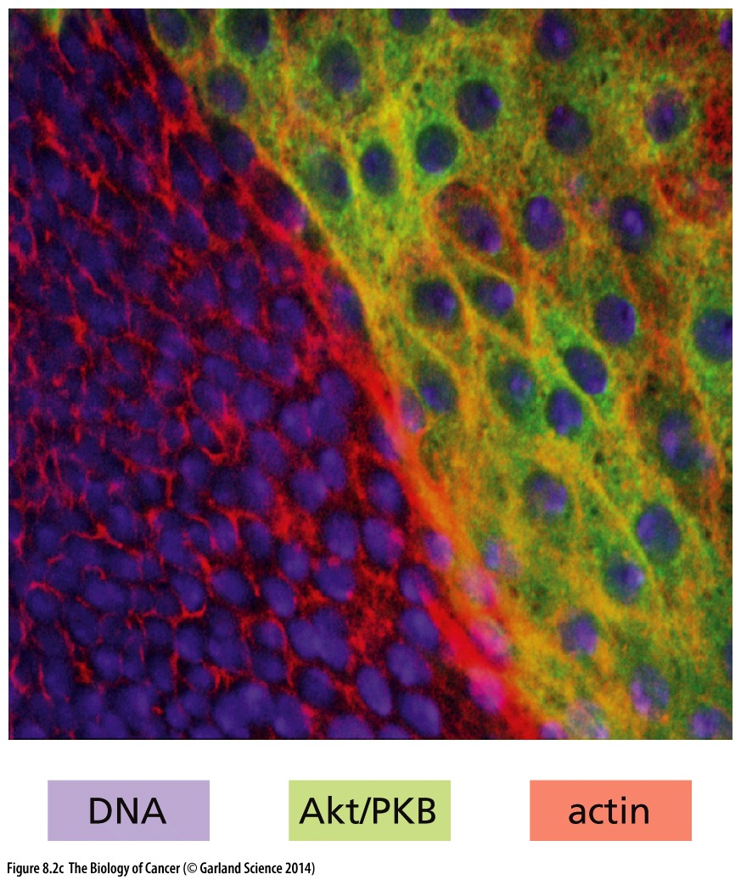
Figure 8.2 Growth versus proliferation
The Akt/PKB protein is frequently hyperactivated in human cancers. In an imaginal disc of a developing Drosophila larva, Akt/PKB (green) that has been hyperactivated in a portion of cells (upper right) causes a great increase in nuclear and overall cell size relative to cells with normal Akt/PKB (lower left); similar increases in mammalian cells are also observed in response to hyperactive Akt/PKB.
Notes:
AKT---TSC---mTOR---pS6 信号特异参与细胞生长调控

Slide 10
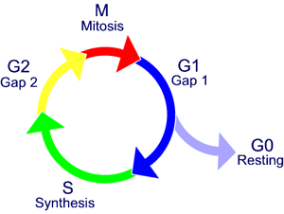
General overview of eukaryotic cell cycle
Cell growth/Cell proliferation
Cell growth is usually a continuous process
Cell cycle
DNA replication only happens in S phase
Notes:
细胞做事有规律, 一步一步来, 先复制DNA, 再分配DNA, 不会同时复制和分配DNA

Slide 11
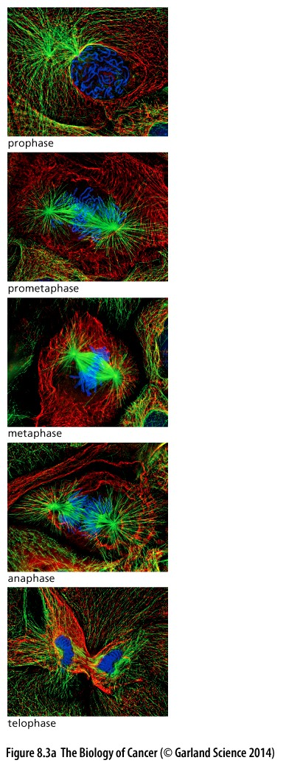
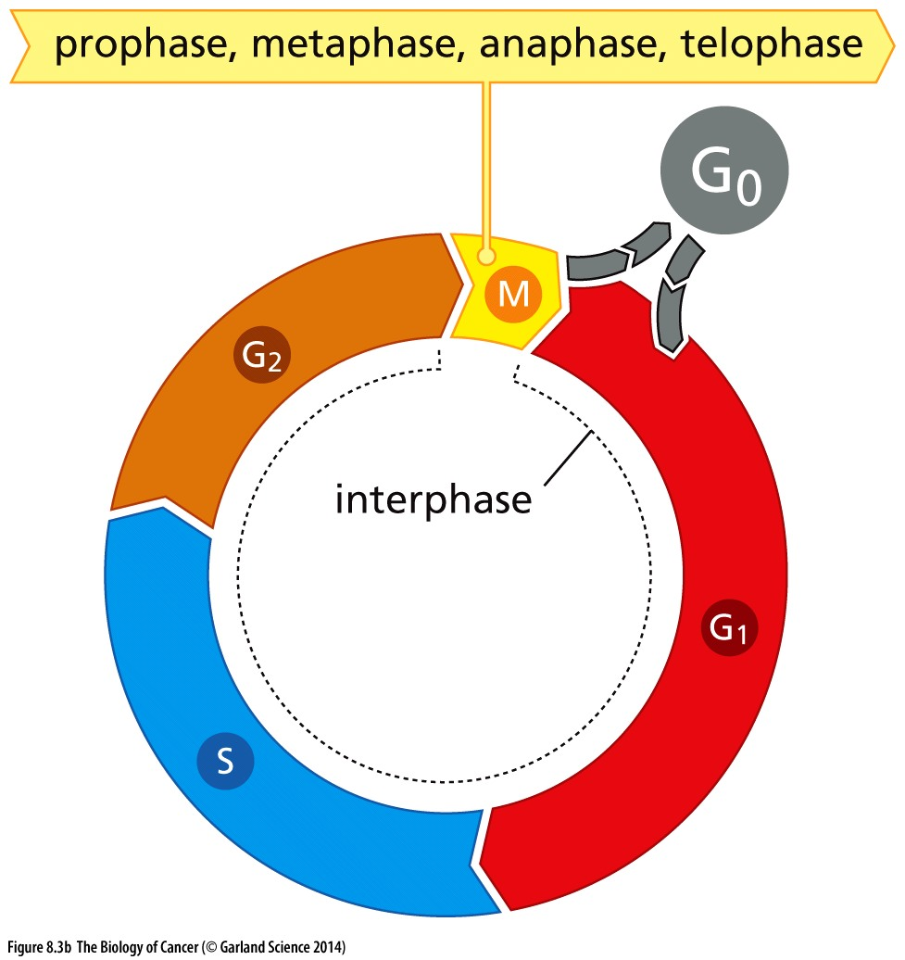
Figure 8.3 The mammalian cell cycle

Slide 12
Eukaryotic Cell cycle time frame
Mammalian cells, total cell cycle time ~~24hours
G0 0 -- for ever
G1 ~~ 9hours
S ~~ 10 hour
G2 ~~ 4hour
M ~~ 1hour
For a typical rapidly proliferating human cell with a total cycle time of 24 hours. Budding yeasts, for example, can progress through all four stages of the cell cycle in only about 90 minutes. Even shorter cell cycles (30 minutes or less) occur in early embryo cells shortly after fertilization of the egg.

Slide 13
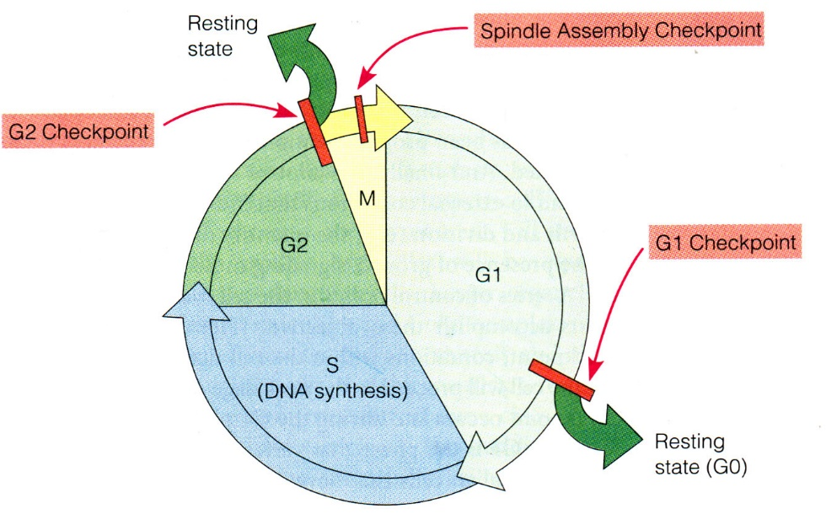
Cell cycle checkpoints
① G1 checkpoint, also known as the restriction or start checkpoint;
② G2/M checkpoint, DNA damage checkpoint;
③ the metaphase checkpoint, also known as the spindle checkpoint.
Notes:
细胞周期运行如同一台自动化的机器，很多运行过程机器自己控制，但是也有如下三个过程受到外界或内部信号调控，称为“Cell cycle checkpoints”，显然受调控的过程与肿瘤关系密切。

Slide 14
Cell cycle checkpoints in cancer
Examples:
Rb in restriction checkpoint (R point);
P53 in G2/M checkpoint, DNA damage checkpoint;
Notes:
今天的核心内容就是Rb-R point 机制；下一节课是P53与DNA damage checkpoint

Slide 15
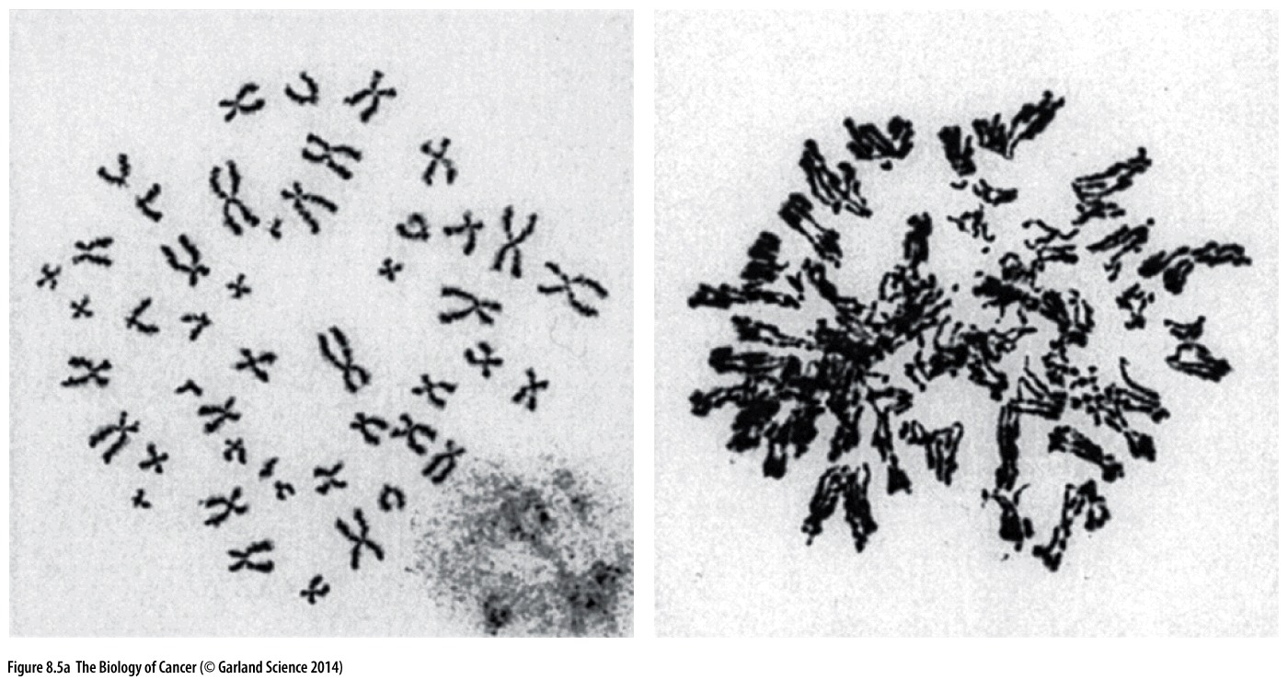
Figure 8.5 Consequences of loss of checkpoint controls
Loss of critical cell cycle checkpoint control mechanisms is often manifested as an altered karyotype（核型紊乱）. (A) The normal human karyotype (left) is contrasted with that of a cell that has been deprived of the Rad17 checkpoint protein (right), which is responsible for preventing inadvertent re-replication of already-replicated chromosomal DNA, resulting in endoreduplication and increases in the ploidy of the cell.
Notes:
核型紊乱是癌症细胞的特征，这背后的根源就是cell cycle checkpoint 功能的缺失。

Slide 16
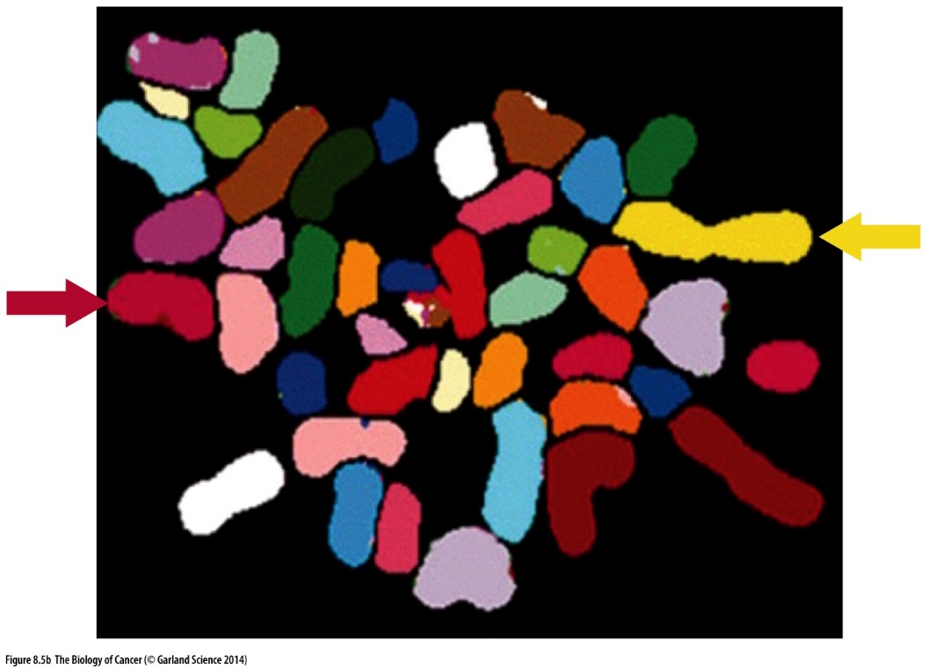
Figure 8.5 Consequences of loss of checkpoint controls
The Bub1 protein normally prevents separation of chromosomes in the event that one or more chromosomal pairs are not properly aligned on the metaphase plate. In its absence, cells gain or lose chromosomes, as seen in this spectral karyotyping (SKY) analysis, which indicates that this human cell has only one Chromosome 1 (yellow, arrow, right) and one Chromosome 6 (red, arrow, left). (Several other red-colored chromosomes are evident but can be identified as belonging to other chromosome pairs by their size and shading.)
Notes:
Bub1是spindle checkpoint 的重要成分，该基因在肿瘤中的功能异常导致细胞核型异常

Slide 17
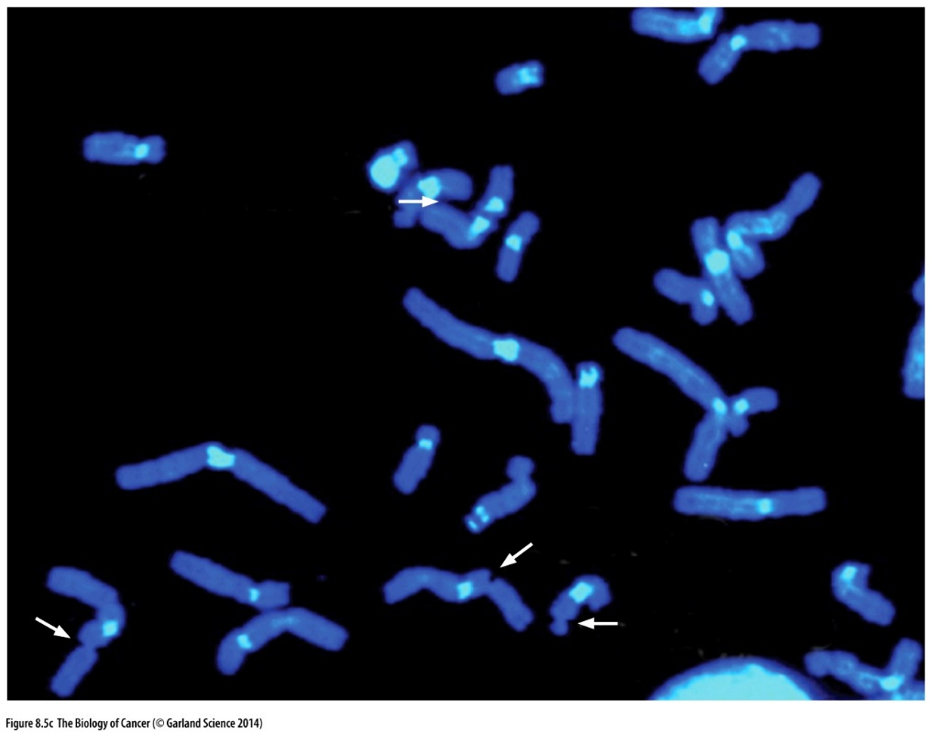
Figure 8.5 Consequences of loss of checkpoint controls
The ATR (ataxia telangiectasia and Rad3 related)
protein kinase is responsible for, among other functions, halting further DNA replication until stalled replication forks are repaired. In its absence, fragile sites—sites in the chromosome prone to breakage—become visible upon karyotypic analysis. Here, fragile sites on human Chromosomes 3 and 16 (white arrows) are apparent in cells lacking ATR function.
Notes:
ATR是DNA damage checkpoint的成员，该基因功能异常也会导致核型异常（如图显示：染色体断裂）

Slide 18
8.2 Cells make decisions about growth and quiescence
during a specific period in the G1 phase
Notes:
是静息， 还是增殖？ 细胞的一个重要选择。也是细胞周期第一个检验点的内容

Slide 19
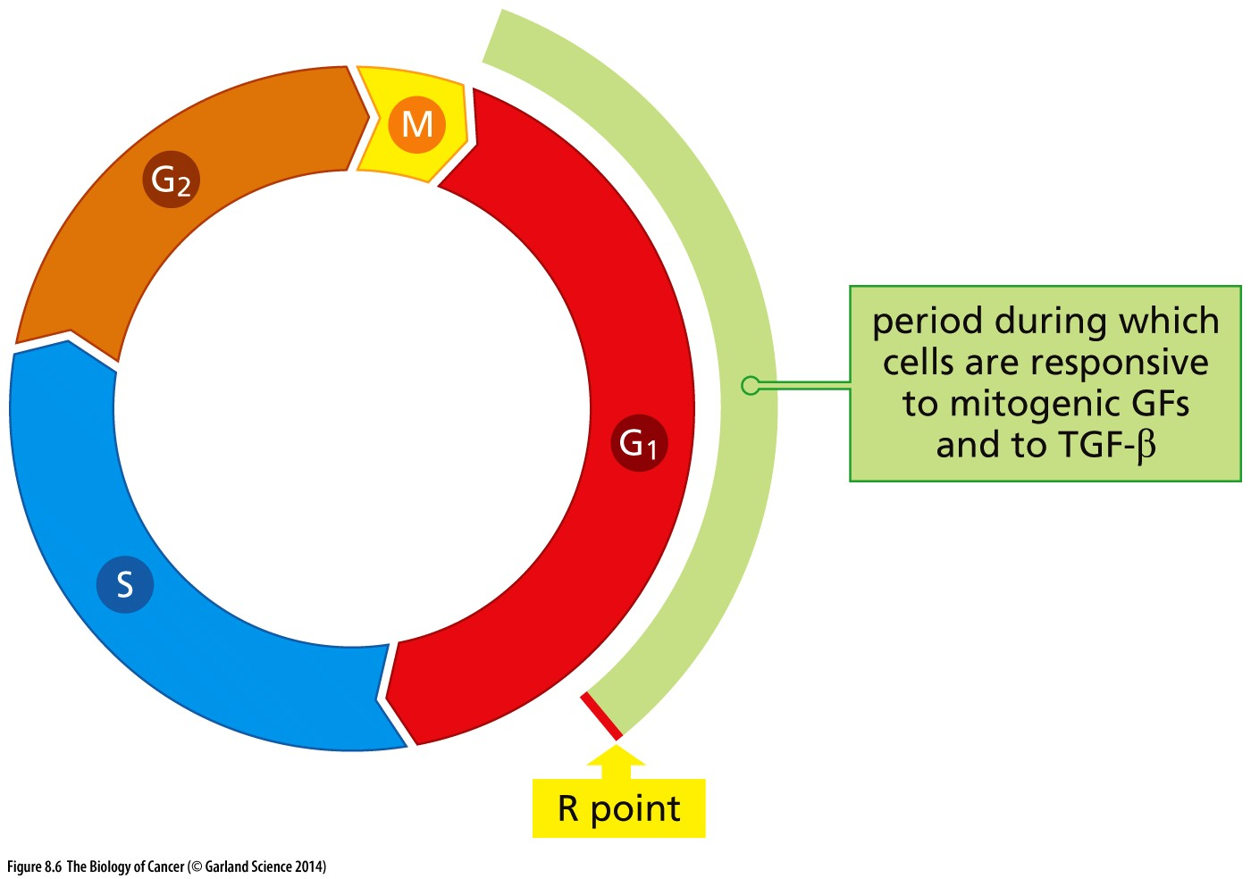
Figure 8.6 Responsiveness to extracellular signals during the cell cycle
Cells respond to extracellular mitogens and inhibitory factors (such as TGF-β) only in a discrete window of time that begins at the onset of G1 and ends just before the end of G1. The end of this time window is often designated as the restriction (R) point, which denotes the point in time when the cell must make the commitment to advance through the remainder of the cell cycle through M phase, to remain in G1, or to retreat from the active cell cycle into G0.
Notes:
并不是所有的细胞周期过程都受外界信号调控！！！ 只有第一个细胞周期检验点受外界信号调控，余下2个细胞周期检验点受细胞内部信号的调控。

Slide 20
8.3 Cyclins and cyclin-dependent kinases constitute the core components of the cell cycle clock
Notes:
本次课第二部分内容：细胞周期调控机制

Slide 21
2001 Nobel Prize in Physiology or Medicine
“for their discovery of key regulators of the cell cycle”
Notes:
有兴趣可以深入了解细胞周期调控研究的历史

Slide 22
Major discoveries in cell cycle
发现者
时间
主要发现
Leland H. Hartwell 1970 Cdc28 (budding yeast)
Paul M. Nurse 1976 Cdc2 (fission yeast)
Tim Hunt 1983 Cyclin
Yoshio Masui 1971 Maturation promoting factor (MPF)
Cdc28 = Cdc2 = cyclin-dependent kinase (CDK)
MPF = CDK + cyclin
Notes:
简单，beautiful 机制

Slide 23
Current cell cycle mechanisms
G1-Cdk
G1/S-Cdk
S-Cdk
M-Cdk
Notes:
过了start就没有回头

Slide 24
Notes:
重点关注 Cyclin D, Cyclin E

Slide 25
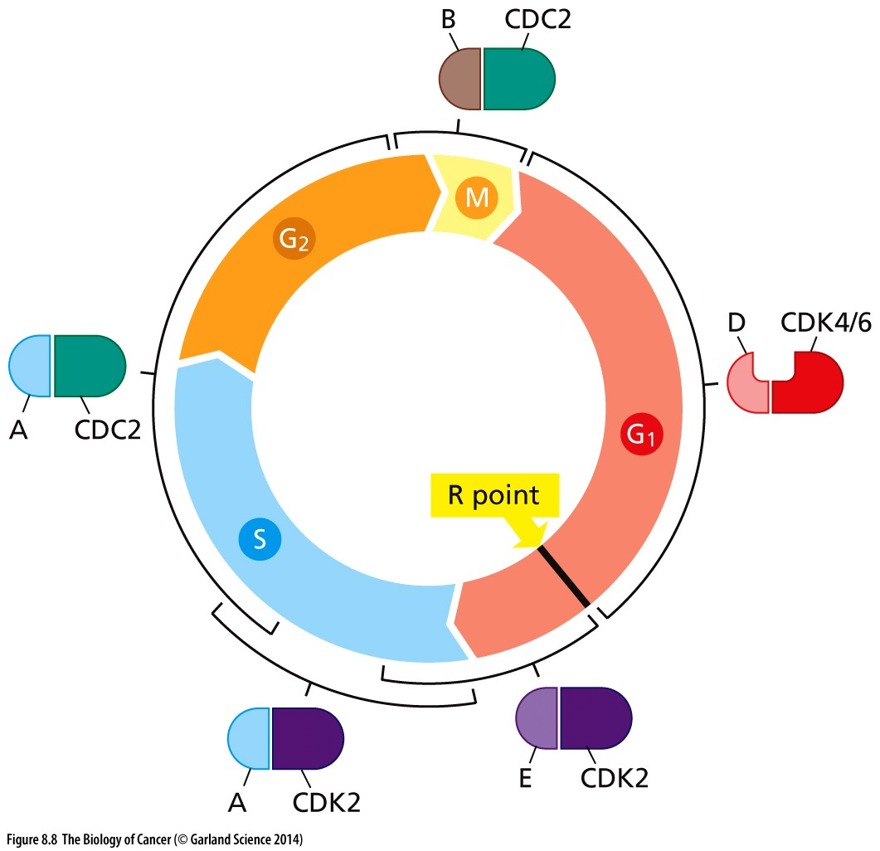
Figure 8.8 Pairing of cyclins with cyclin-dependent kinases
Each type of cyclin pairs with a specific cyclin-dependent kinase (CDK) or set of CDKs. The D-type cyclins (D1, D2, and D3) bind CDK4 or CDK6, the E-type (E1 and E2) bind CDK2, the A-type cyclins (A1 and A2) bind CDK2 or CDC2, and the B-type cyclins (B1 and B2) bind CDC2. The brackets indicate the periods during the cell cycle when these various cyclin–CDK complexes are active.

Slide 26
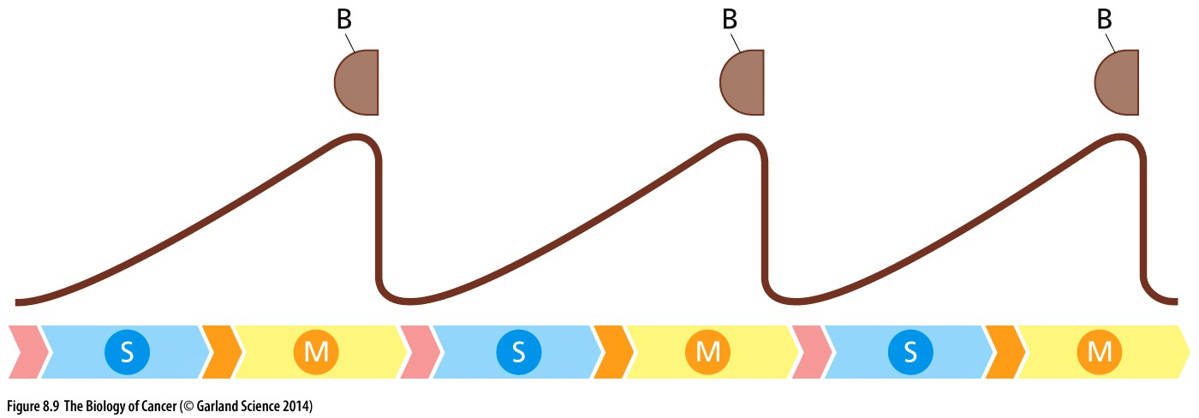
Figure 8.9 Cell cycle–dependent fluctuations in cyclin B levels
The cyclic fluctuations in the levels of cyclin B in early frog and sea urchin(海胆) embryos gave cyclins their name. These fluctuations were noticeable because the cell cycles in these early embryos are synchronous, i.e., all cells enter into M phase simultaneously. In these early embryos, the G1 and G2 phases of the cell cycle (orange, pink chevrons) are virtually absent and the cells, in effect, alternate between M and S phases.
Notes:
前面提到过Tim Hunt在sea urchin 中发现cyclin

Slide 27
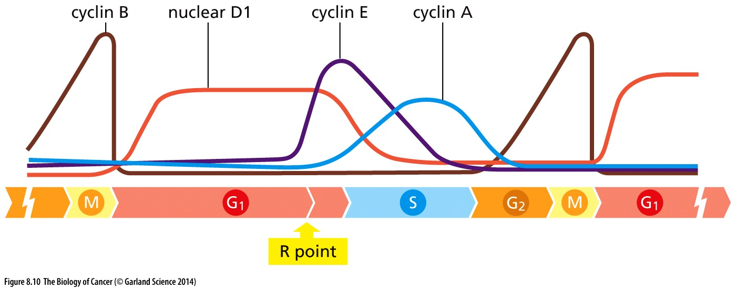
Figure 8.10 Fluctuation of cyclin levels during the cell cycle
The levels of most of the mammalian cyclins fluctuate dramatically as cells progress through the cell cycle. For most of these cyclins, these fluctuations are tightly coordinated with the schedule of advances through the various cell cycle phases. However, in the case of the D-type cyclins, extracellular signals, notably those conveyed by growth factors, strongly influence their levels.
Notes:
Cyclin D, critical cyclin regulated by outside signal !!

Slide 28
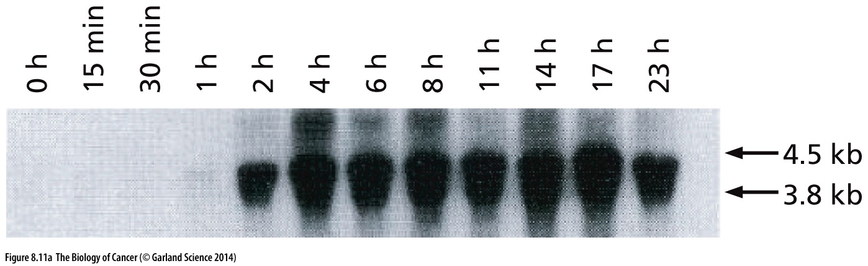
Figure 8.11 Control of cyclin D1 levels
Cyclin D1 was discovered as a protein whose levels are strongly induced by exposure of macrophages to the mitogen CSF-1 (colony-stimulating factor-1). Here, macrophages that had been starved of CSF-1 were exposed to fresh CSF-1 and the amounts of cyclin D1 mRNA at subsequent times thereafter were determined by RNA (Northern) blotting.

Slide 29
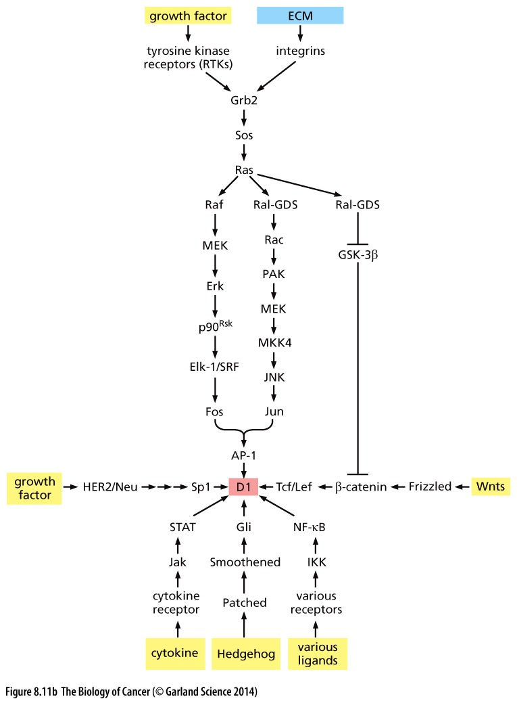
Figure 8.11 Control of cyclin D1 levels
The control of cyclin D1 levels by extracellular mitogens can be explained, in part, by a signal transduction cascade that leads from growth factor receptors (RTKs) to the AP-1 transcription factor (TF), one of a number of factors that modulate the transcription of the cyclin D1 gene. (AP-1 is a heterodimeric TF formed from Fos and Jun subunits, each encoded by a proto-oncogene.) In addition, a number of other signaling cascades converge on the promoter of this gene, not all of which are illustrated in this figure.

Slide 30
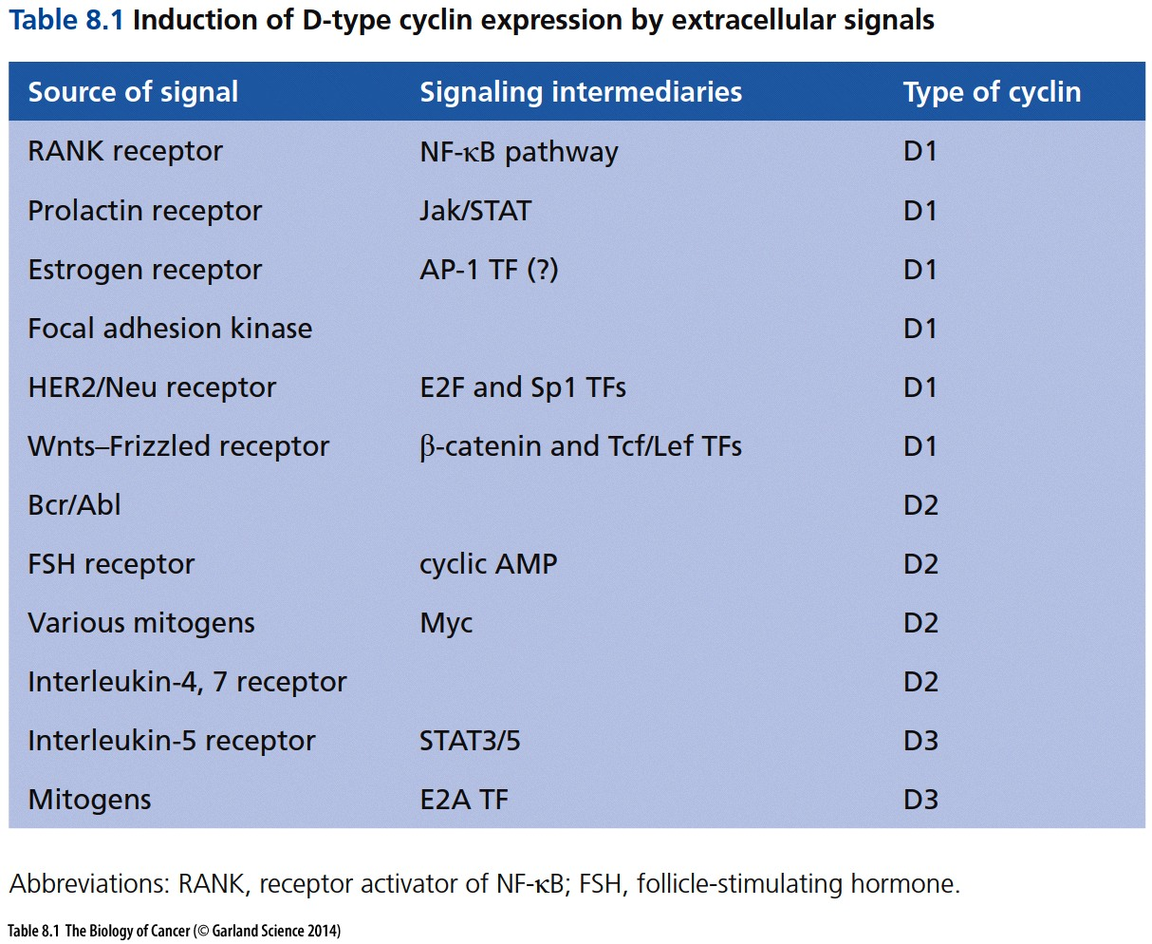

Slide 31
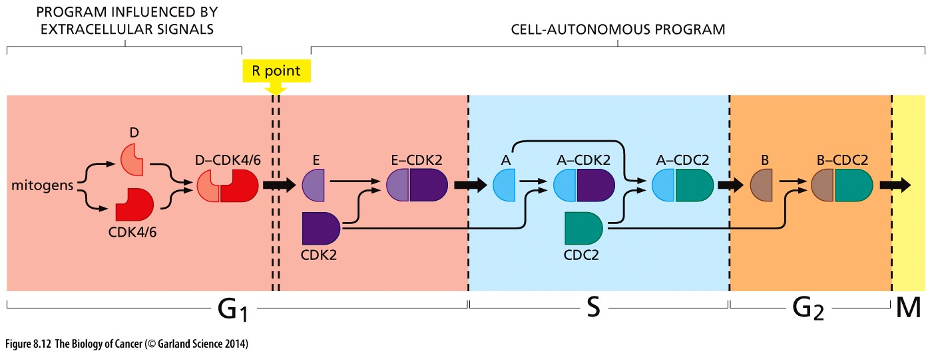
Figure 8.12 Control of cyclin levels during the cell cycle
While extracellular signals strongly influence the levels of D-type cyclins during most of the G1 phase of the cell cycle. The activation of the remaining cyclin–CDK complexes occurs on a predictable schedule that appears to be independent of extracellular physiologic signals. In part, this coordination is achieved because the cyclin–CDK complexes in one phase of the cell cycle are responsible for activating those in the subsequent phase (indicated here) and for shutting down those that were active in the previous phase (not shown).
Notes:
如同多米诺骨牌。。。

Slide 32
8.4 Cyclin–CDK complexes are also regulated by CDK inhibitors
Notes:
本次课中，细胞周期调控的第二个机制： CDK inhibitor

Slide 33
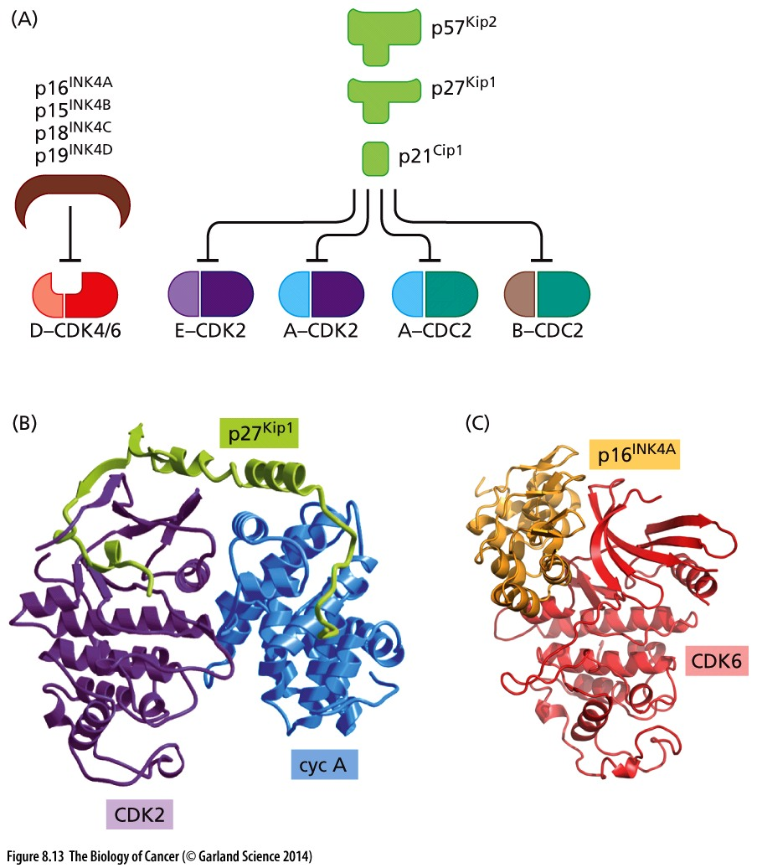
Figure 8.13 Actions of CDK inhibitors
Notes:
CDK inhibitor编码基因是非常重要的抑癌基因，如P16, P21, P27…

Slide 34
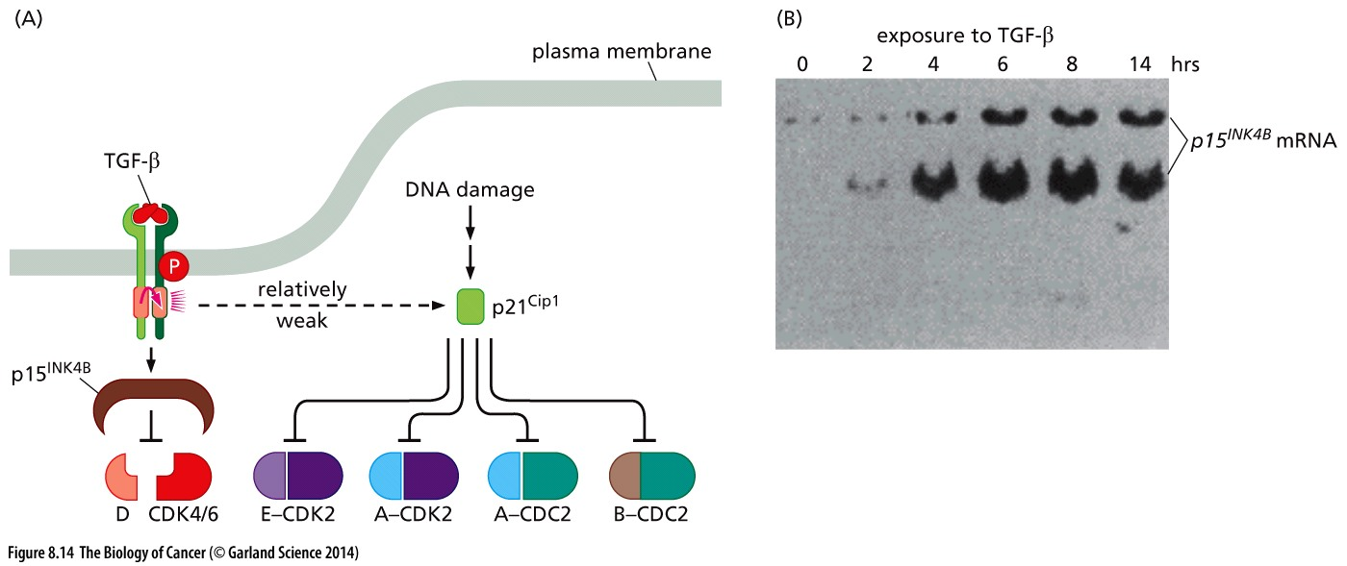
Figure 8.14 Control of cell cycle progression by TGF-β

Slide 35
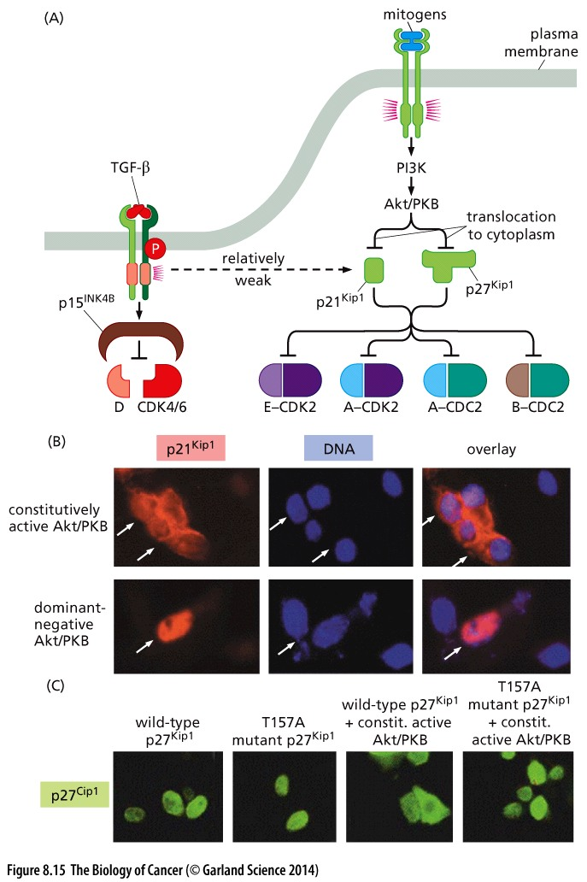
Figure 8.15 Control of cell cycle advance by extracellular signals
Countervailing extracellular signals influence the cell cycle machinery, in part through their ability to control the levels and intracellular localization of CDK inhibitors.
T157A mutant p27 can not be phosphorylated by AKT
Notes:
Protein regulation in signaling: level; location; modification. 具体通路细节仅供参考

Slide 36
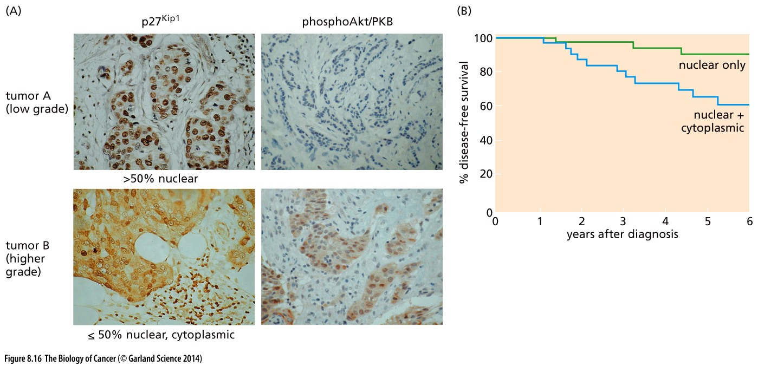
Figure 8.16 Suppression of p27Kip1 function by Akt/PKB in human breast cancers

Slide 37
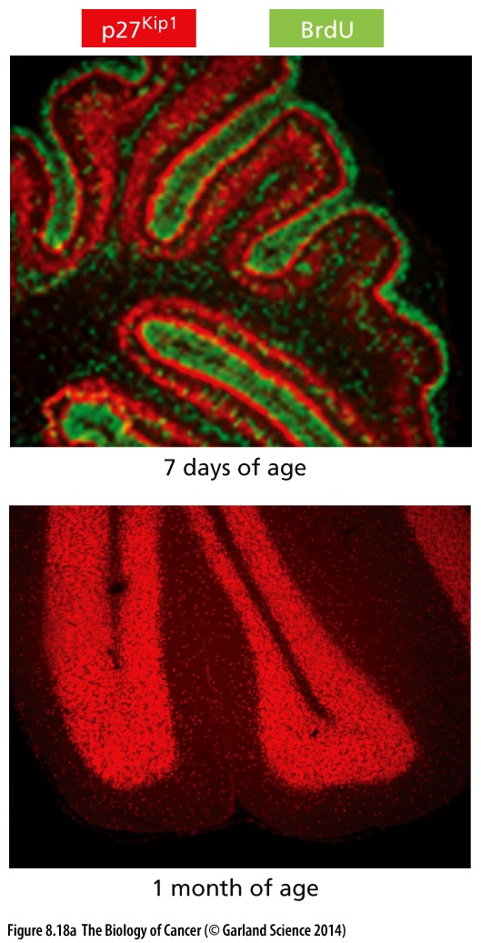
Figure 8.18 Imposition by p27^{Kip1} and p57^{Kip2} of post-mitotic states during development
During the course of cerebellar development in the mouse, proliferating cells can be detected through their incorporation of bromodeoxyuridine (BrdU), a thymidine analog; they are revealed here at postnatal day 7 by immunofluorescence using an antibody that recognizes BrdU-containing DNA (green). The levels of p27Kip1 have been gauged by use of a fluorescence-tagged antibody that recognizes it in the same section (red). As is apparent, p27Kip1 accumulates in cells that have ceased proliferating (above). By one month of age, cerebellar development is complete (below), and the levels of p27Kip1 (red) are maintained at high levels throughout adulthood, ostensibly to hold these cells in a post-mitotic state.
Notes:
BrDU 和 p27不共存

Slide 38
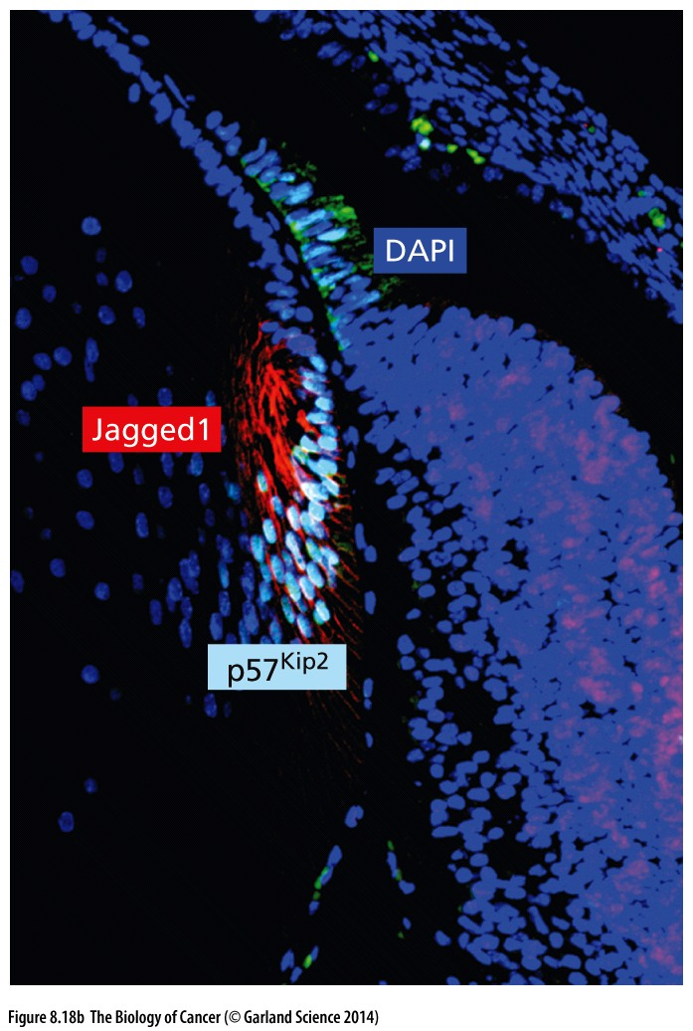
Figure 8.18 Imposition by p27^{Kip1} and p57^{Kip2} of post-mitotic states during development
In the developing ocular lens(晶状体) of the mouse (day 17.5 of gestation), the Notch ligand Jagged1 (red) induces expression of a transcriptional repressor, Herp2 (not shown), which in turn represses expression of p57Kip2 (light blue). By suppressing p57Kip2 expression, Jagged1, acting via a Notch receptor, can ensure that cells remain in an actively proliferating state until the developing lens grows to an appropriate size, after which p57Kip2 expression is then permitted, allowing it to impose a postmitotic state. Cell nuclei are revealed by the DAPI dye (dark blue).
Notes:
体内情况，供参考

Slide 39
8.5 Viral oncoproteins reveal how pRb blocks advance through the cell cycle

Slide 40
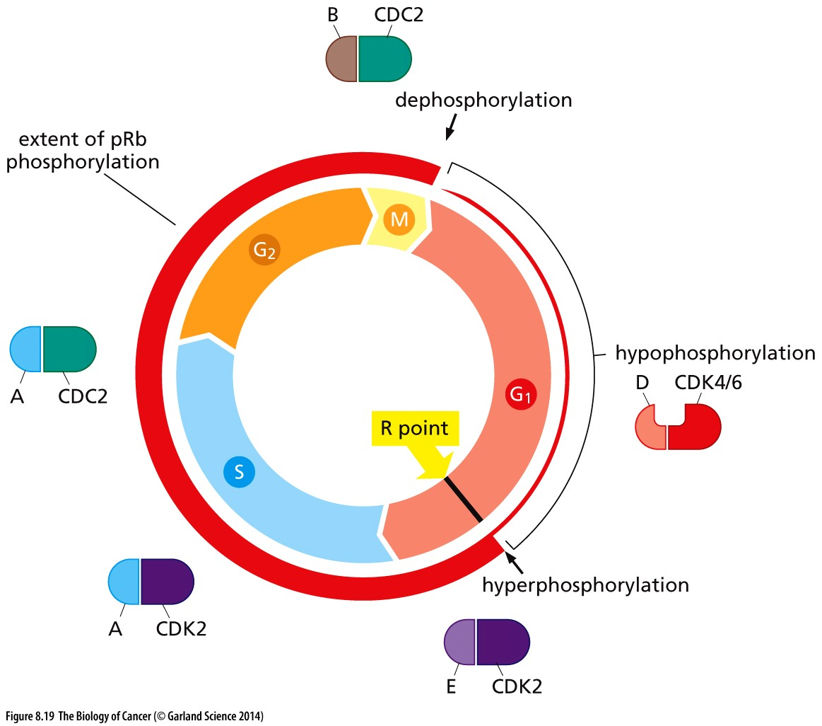
Figure 8.19 Cell cycle–dependent phosphorylation of pRb
As cells pass through the M/G1 transition, virtually all of the existing phosphate groups are stripped off pRb, leaving it in an unphosphorylated configuration. As cells progress through G1, a single phosphate group is attached at any one of 14 different phosphorylation sites (by cyclin D-CDK4/6 complexes), yielding hypophosphorylated pRb. However, when cells pass through the restriction (R) point, cyclin E–CDK2 complexes phosphorylate pRb on at least 12 more sites, placing it in a hyperphosphorylated state. Throughout the remainder of the cell cycle, the extent of pRb phosphorylation remains constant until cells enter into M phase.

Slide 41
Rb regulation in cancer
The fact that pRb hyperphosphorylation occurs in concert with passage through the R point provided the first hint that this protein is the molecular governor of the R-point transition. An additional, critical clue came from the discovery in 1988 of physical interactions between DNA tumor virus–encoded oncoproteins and pRb.
DNA tumor viruses are able to transform cells and do so through the use of virus encoded oncoproteins. Unlike the oncoproteins of RNA tumor viruses such as RSV, the DNA tumor viruses employ oncoproteins that have little if any resemblance to the proteins that exist naturally within uninfected cells (see Sections 3.4 and 3.6).

Slide 42
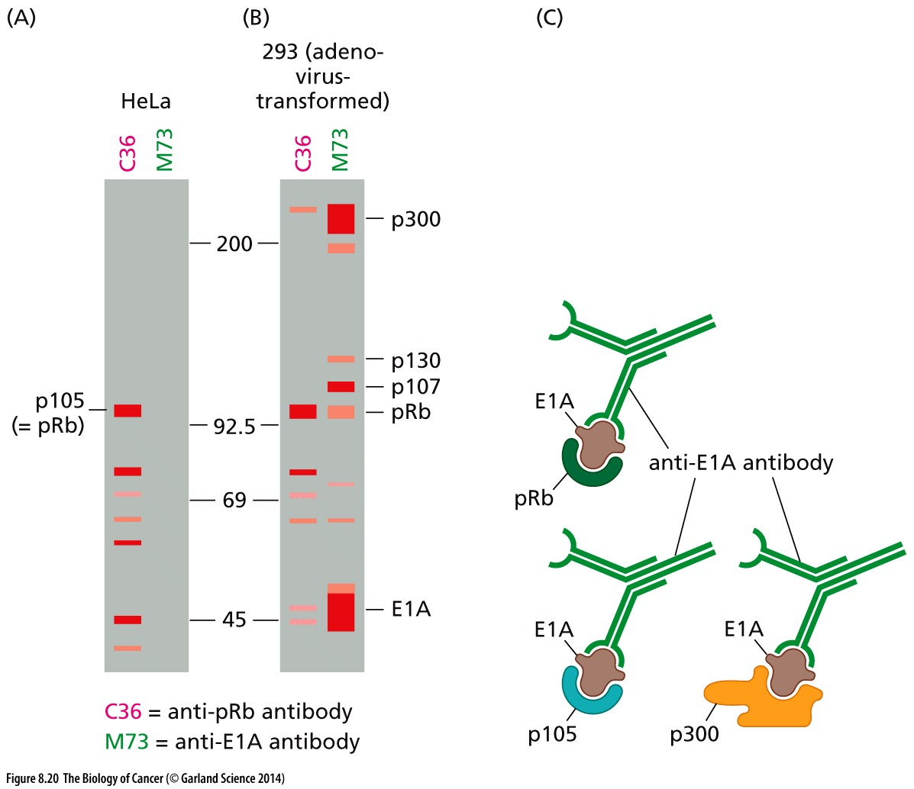
Figure 8.20 Co-precipitation of cellular proteins with adenovirus E1A
Immunoprecipitation → silver staining

Slide 43
DNA tumor virus oncoproteins target Rb
These three different DNA tumor virus oncoproteins (E1A, large T antigen, and E7) are structurally unrelated to one another, yet all of them target a common cellular protein— pRb. This suggests that convergent evolution led, on at least three occasions, to the development of viral oncoproteins capable of perturbing cellular pRb.

Slide 44
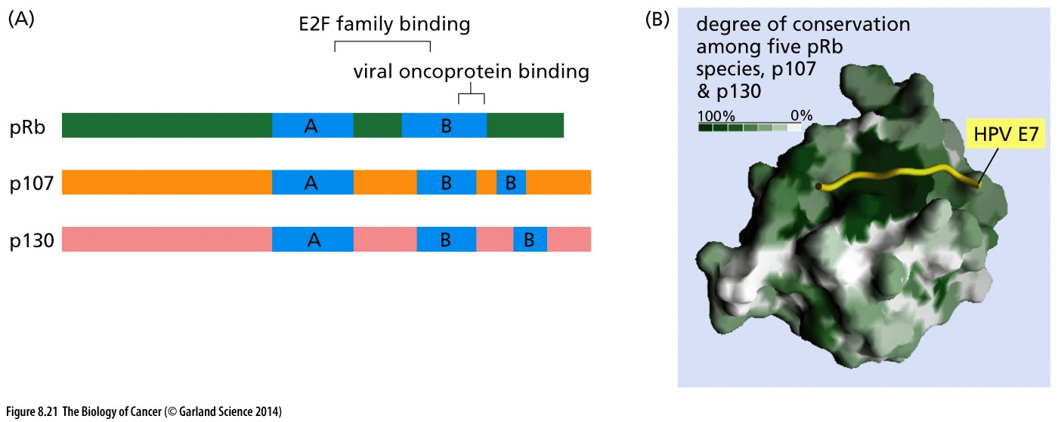
Figure 8.21 Pocket proteins
pRb is one of three structurally related proteins that together are often called “pocket proteins.” All three are bound by viral oncoproteins, such as adenovirus E1A, SV40 large T, and human papillomavirus E7. All three pocket proteins are phosphorylated by cyclin D–CDK4/6 complexes, and each binds its own subset of E2F transcription factors, as discussed later. The “pocket” that interacts with both viral oncoproteins and cellular E2F transcription factors is composed of A and B domains (blue).

Slide 45
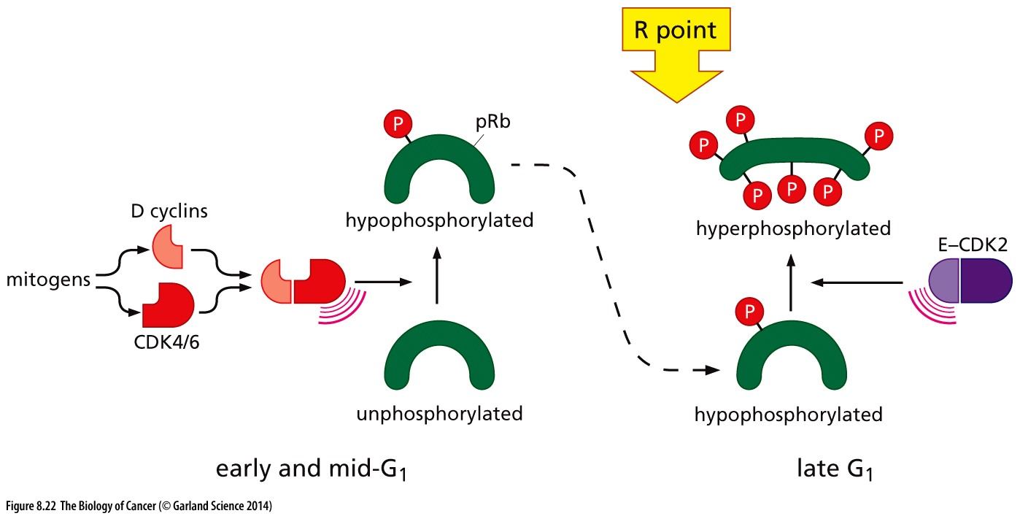
Figure 8.22 Control of the restriction point transition by mitogens
The levels of D-type cyclins are controlled largely by extracellular signals. Because the D-type cyclins, acting with their CDK4 and CDK6 partners, are able to drive pRb hypophosphorylation— an apparent prerequisite to the R-point transition—this ensures that this transition is responsive to extracellular signals (see also Figure 8.15). Cyclin E–CDK2 complexes then take over to complete the work of decommissioning （正式停止使用） pRb by placing it in a hyperphosphorylated state, causing a >10-fold increase in its phosphorylation that results in the complete functional inactivation of pRb.

Slide 46
8.7 E2F transcription factors enable pRb to implement growth-versus-quiescence decisions
Notes:
How Rb function in R point regulation?

Slide 47
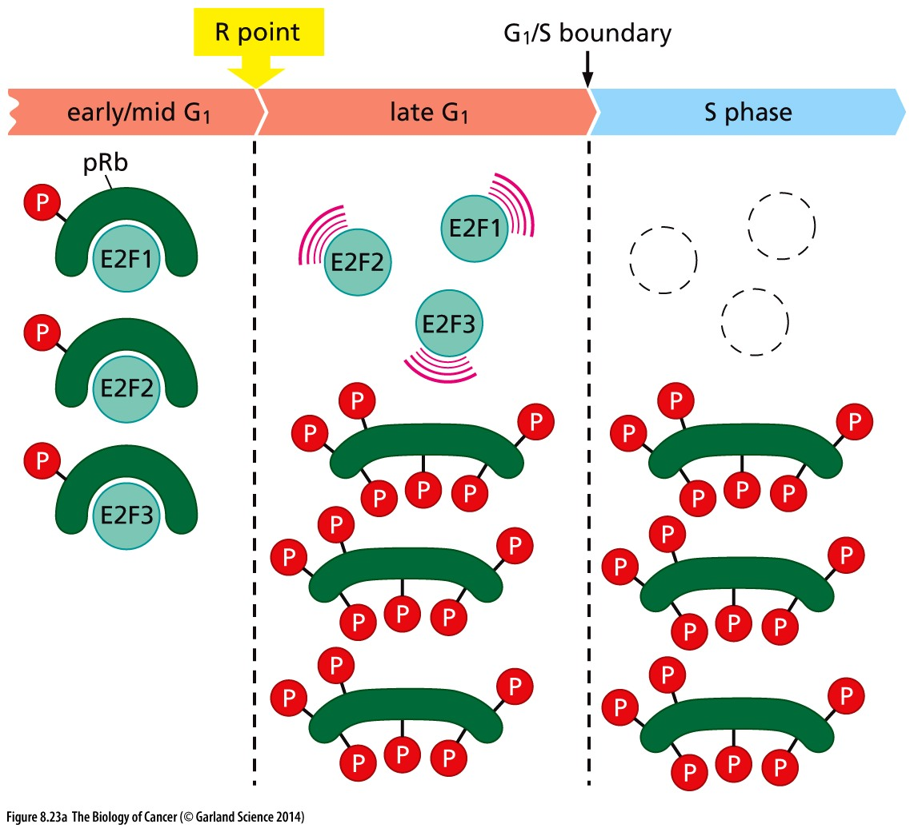
Figure 8.23 E2Fs and their interactions
When pRb (and its two cousins, p107 and p130) are in their unphosphorylated or hypophosphorylated state, they bind E2Fs, however, when hyperphosphorylated, pRb and its cousins (see Figure 8.21) dissociate from the E2Fs (Figure 8.23A).

Slide 48
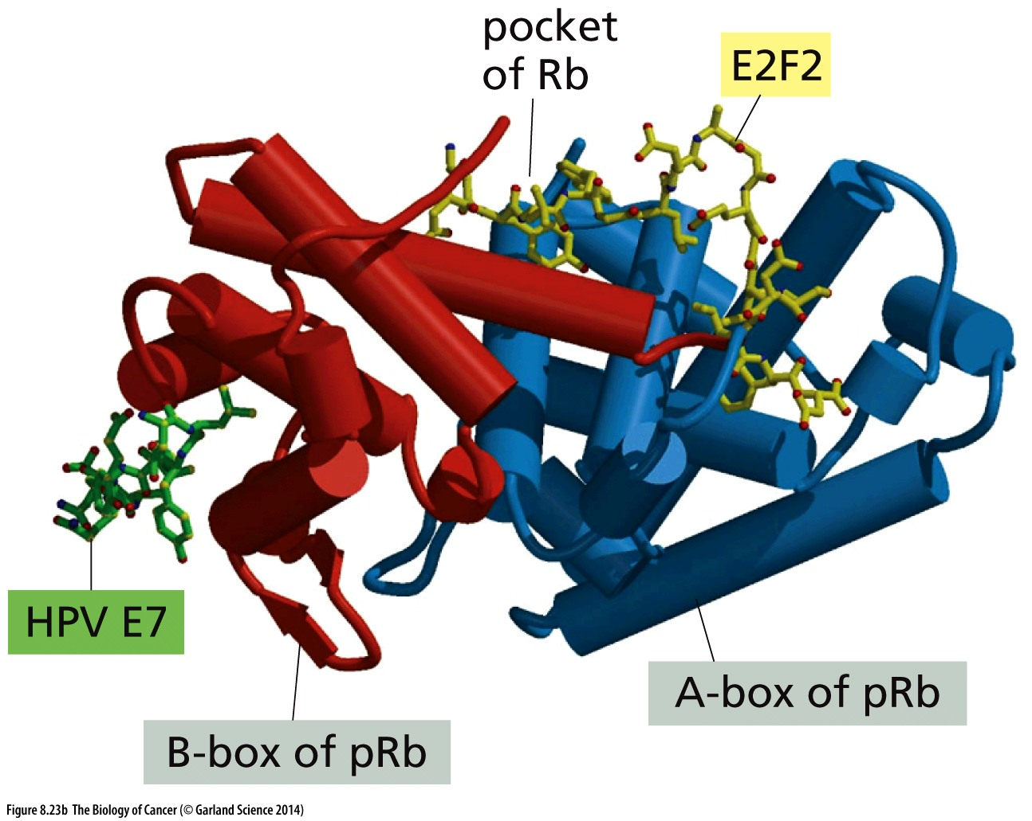
Figure 8.23 E2Fs and their interactions
(B) The binding of E2Fs such as E2F2 by pRb is prevented by several DNA tumor virus oncoproteins. Here we see how a segment of the human papillomavirus E7 oncoprotein binds to a shallow groove of pRb; this binding, together with other secondary binding sites (not yet mapped), perturbs the cavity formed by the B- and A-boxes of pRb, thereby preventing the binding of the C-terminal, transcription-activating domain of E2F2 to this pocket.

Slide 49
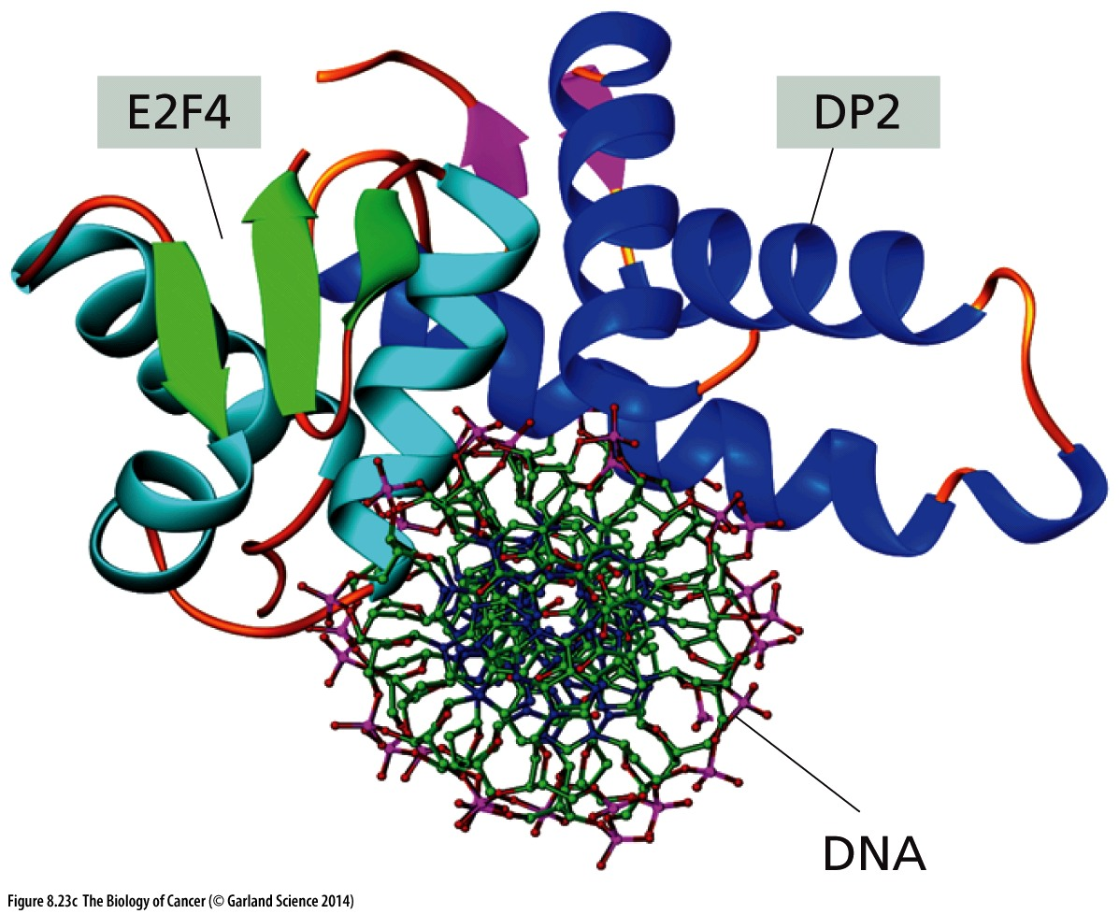
Figure 8.23 E2Fs and their interactions
The term “E2F” is now known to include a class of proteins composed of eight members—E2F1 through E2F8; the first six of these can bind to either a DP1 or a DP2 subunit to form heterodimeric transcription factors (see Figure 8.23C and D); the two others—E2F7 and E2F8—have two DNA-binding domains (DBDs), allowing each to bind DNA without an associated DP1/2 subunit. Once assembled, E2F–DP complexes recognize and bind to a sequence motif in the promoters of various genes that seems to be TTTCCCGC or slight variations of this sequence.

Slide 50
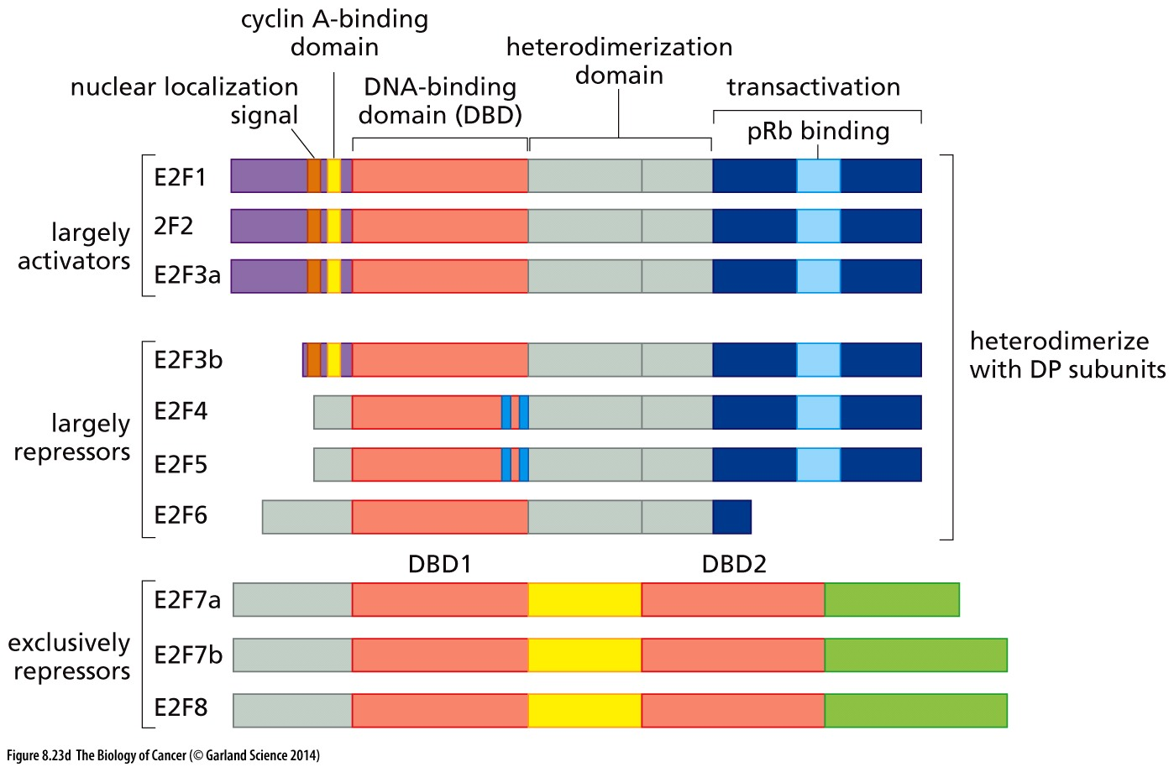
Figure 8.23 E2Fs and their interactions
(D) Because of the existence of variant forms of several E2Fs, they are actually represented by at least 10 distinct protein species. E2Fs 1, 2, and 3a represent transcription-activating E2Fs, while E2F3b, E2F4, E2F5, and E2F6 are largely or exclusively involved in transcriptional repression. E2Fs 7a, 7b, and 8 are atypical E2Fs, in that each has a duplicated DNA-binding domain (DBD) that enables DNA binding in the absence of a DP subunit as partner; these E2Fs are involved exclusively in repression.
Notes:
生命调控的复杂性！并非所有的E2F都参与细胞周期

Slide 51
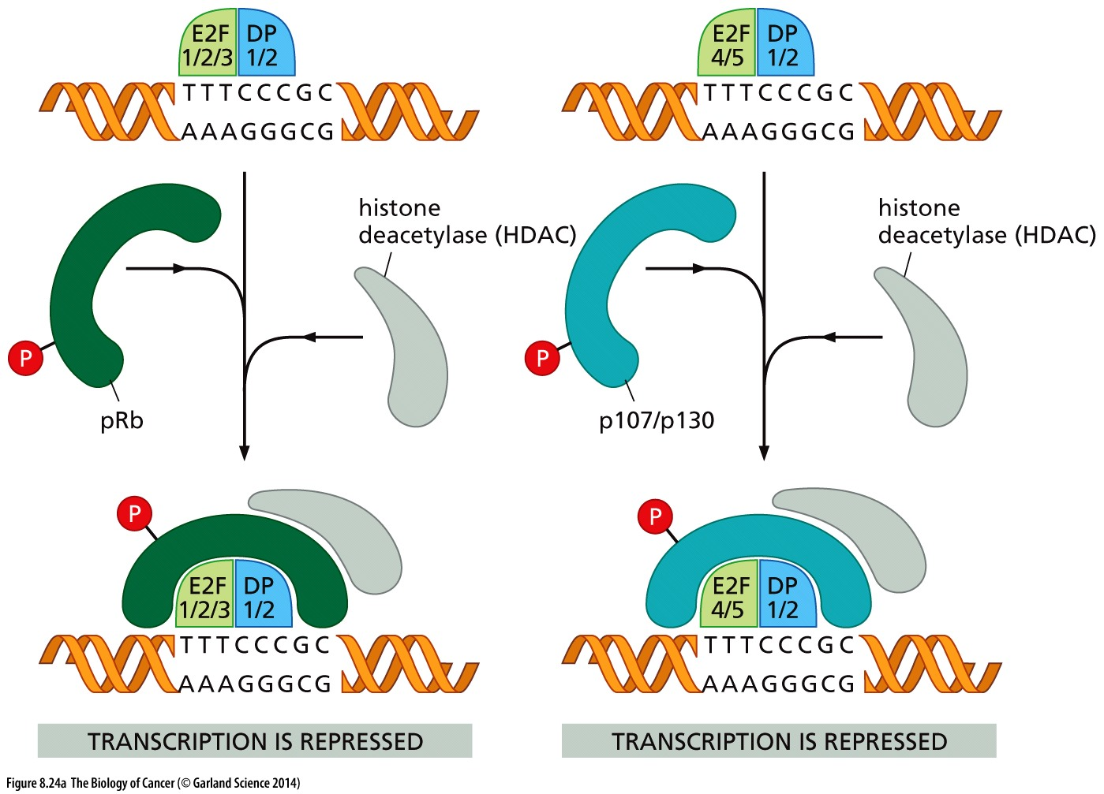
Figure 8.24 Modification of chromatin by pocket proteins
Hypophosphorylated pRb discourages transcription by attracting histone deacetylase (HDAC) enzymes to pRb–E2F complexes that are bound, in turn, to gene promoters; these enzymes prevent transcription by removing acetyl groups from nearby histones, causing the latter to shift into a configuration that is incompatible with the progression of RNA polymerase through the chromatin
Notes:
Rb, P107, P130 belong to Rb family protein.

Slide 52
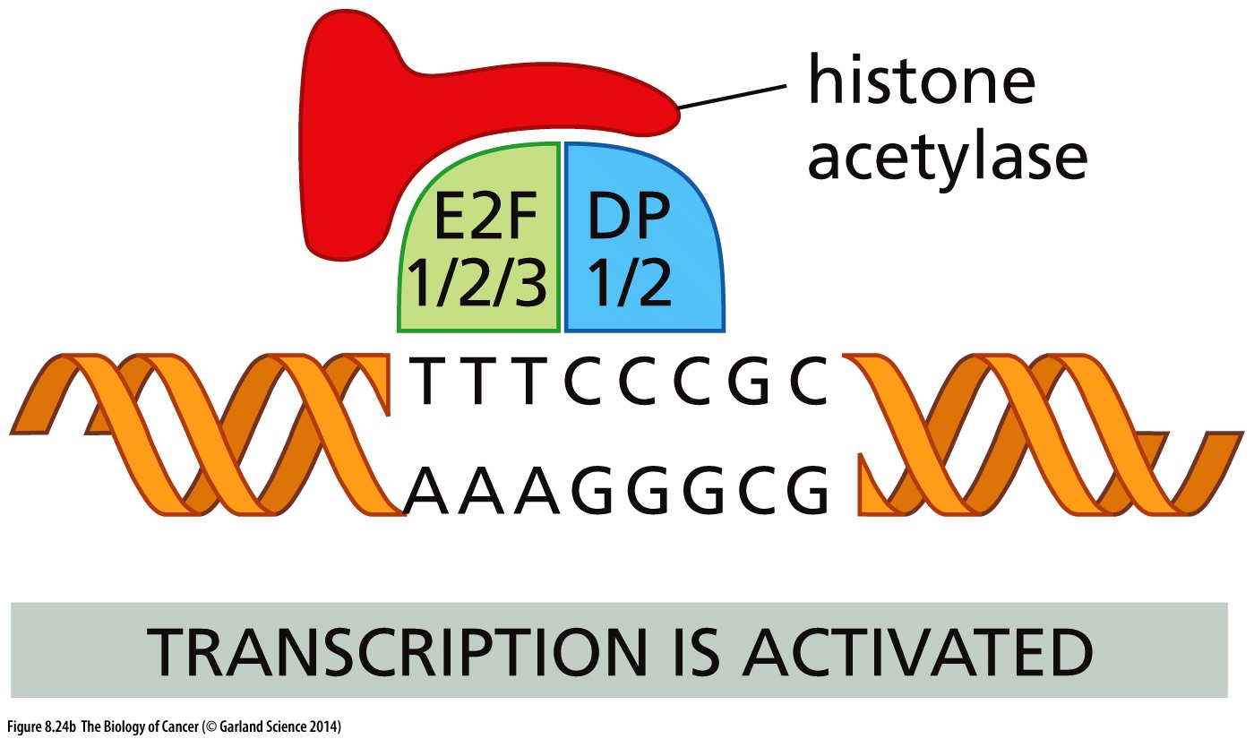
Figure 8.24 Modification of chromatin by pocket proteins
Conversely, when the E2Fs are not complexed with pRb (or its p107 and p130 cousins), they attract histone acetylases (red), which place chromatin in a configuration that is conducive for transcription.
Notes:
第一次课讲到 组蛋白乙酰化调控是基因转录调控的一个关键

Slide 53
E2F transcriptional targets in cell cycle
Cell cycle: CCNA1,2, CCND1,2, CDK2, MYB, E2F1,2,3, TFDP1, CDC25A
Negative regulators: E2F7, RB1, TP107, TP21
Checkpoints: TP53, BRCA1,2, BUB1
Apoptosis: TP73, APAF1, CASP3,7,8, MAP3K5,14
Nucleotide synthesis: thymidine kinase (tk), thymidylate synthase (ts), DHFR
DNA repair: BARD1, RAD51, UNG1,2, FANCA, FANCC, FANCJ
DNA replication: PCNA, histone H2A, DNA pol\alpha and \delta, RPA1,2,3, CDC6, MCM2,3,4,5,6,7
Notes:
How E2F function in cell cycle progression?

Slide 54
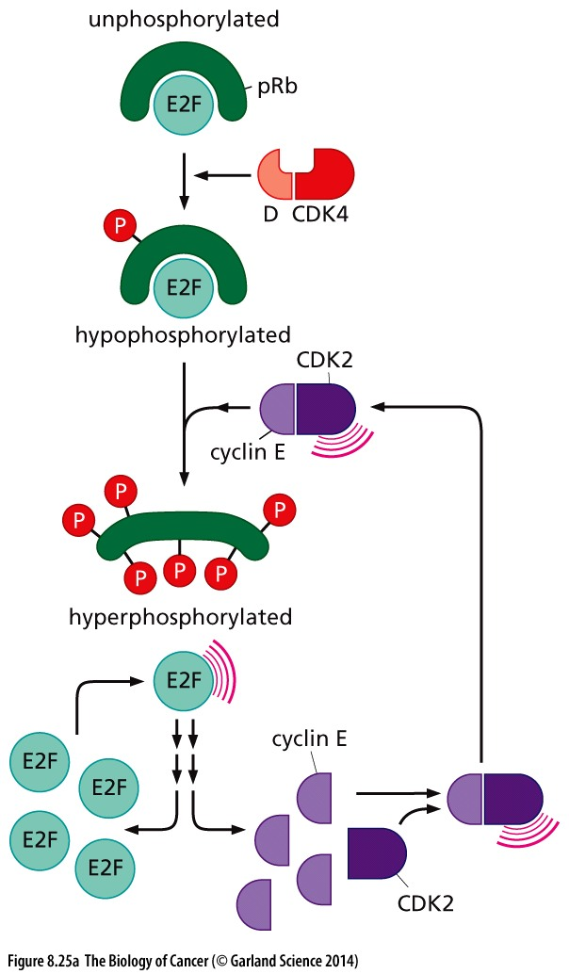
Figure 8.25 Positive-feedback loops and the irreversibility of cell cycle advance
The irreversibility of certain key steps in cell
cycle progression and the rapidity of their execution is ensured, in part, by the activation of certain positive-feedback loops.
Notes:
正反馈，细胞周期一旦决定，不再犹豫，没有回头！

Slide 55
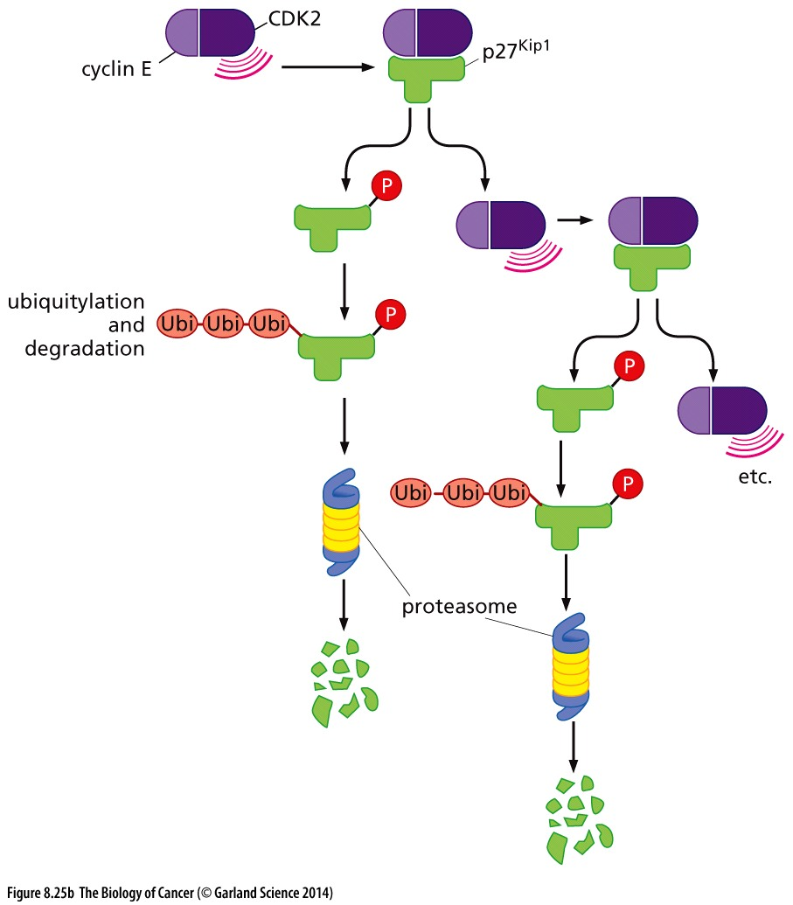
Figure 8.25 Positive-feedback loops and the irreversibility of cell cycle advance
The activation of a small number of E–CDK2 complexes enables the latter to phosphorylate p27Kip1,marking it for ubiquitylation. The consequent degradation of this p27Kip1 liberates more E–CDK2 complexes from inhibition by p27Kip1, allowing this process to repeat itself and amplify its effects.

Slide 56
8.8 A variety of mitogenic signaling pathways control the phosphorylation state of pRb
Growth factors → growth factor receptors → Ras → cyclins D1 and E → inactivation of pRb → activation of E2Fs → S-phase entrance

Slide 57
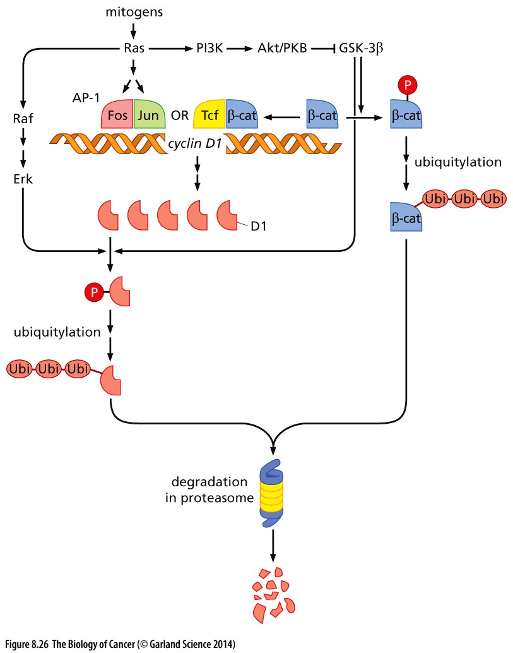
Figure 8.26 Countervailing controls
on cyclin D1 levels
A variety of signaling pathways transducing mitogenic signals modulate the levels of cyclin D1.
Notes:
具体信号通路细节仅供参考

Slide 58
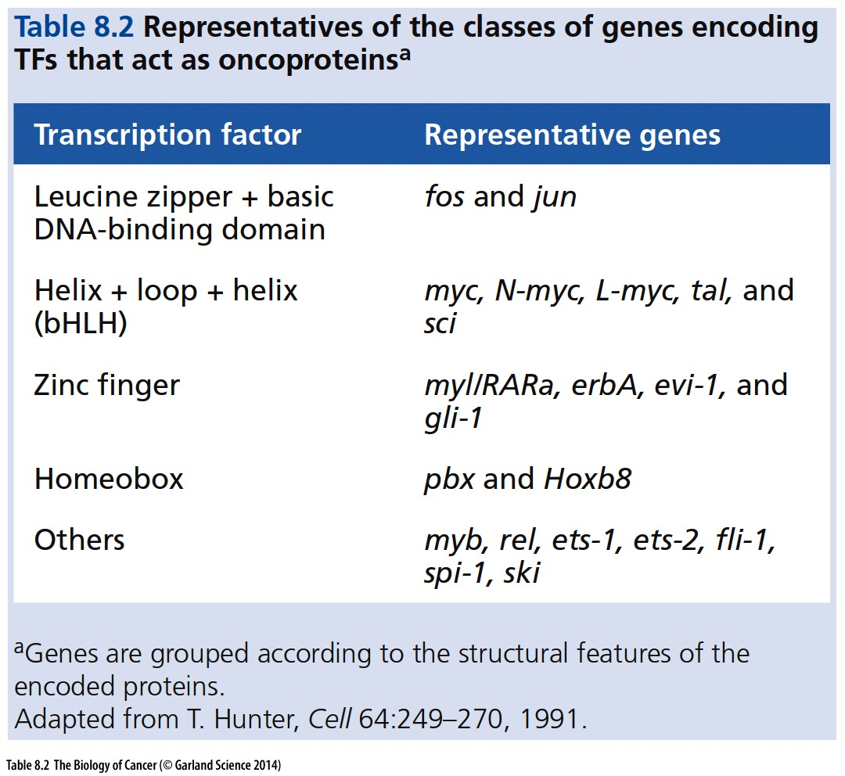
Notes:
除了myc外，其他具有oncoprotein活性的转录因子，具体内容仅供参考

Slide 59
8.9 The Myc protein governs decisions to proliferate or differentiate
More than 70% of human tumors overexpress either Myc (often termed c-Myc) or one of its two close cousins—N-Myc and L-Myc. These three Myc family proteins are only three of a very large (>100 members) family of bHLH transcription factors. Members of this transcription factor family form homo- and heterodimers with themselves and with other members of the family. Such dimeric complexes then associate with specific regulatory sequences, termed E-boxes (composed of the sequence CACGTG), which are found in the promoters of target genes that they regulate (Figure 8.27A).
Notes:
接下来的一点内容提到细胞分化与细胞周期以及肿瘤发生…

Slide 60
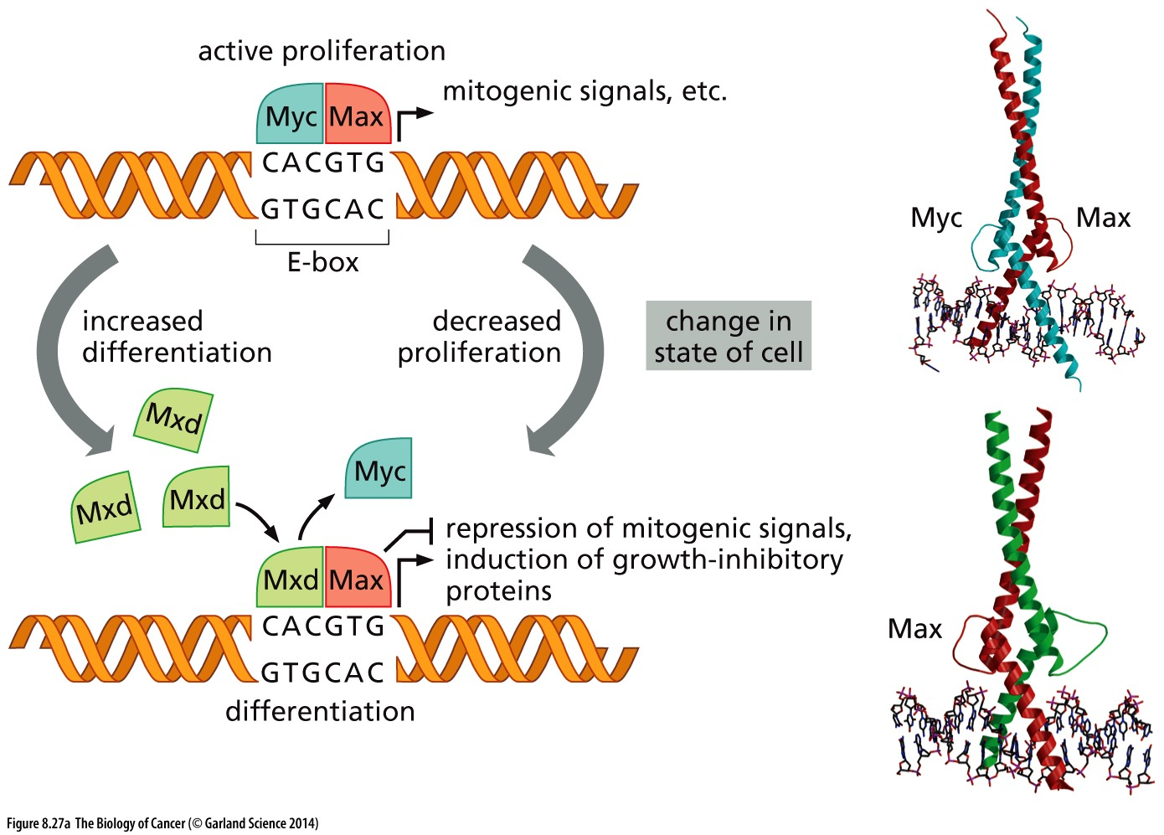
Figure 8.27 Proliferation vs. differentiation
Myc–Max complexes act to promote elongation of nascent transcripts by releasing RNA polymerase II complexes from pause sites located immediately downstream of transcription start sites, allowing polymerase II to proceed with transcription and leading to the synthesis of full-length pre-mRNA transcripts; Mxd–Max complexes prevent this release. As cells differentiate, Mad levels increase progressively and Myc is displaced by Mxd, resulting in the disappearance of Myc–Max complexes, which otherwise would block differentiation (left).
Notes:
具体内容仅供参考

Slide 61
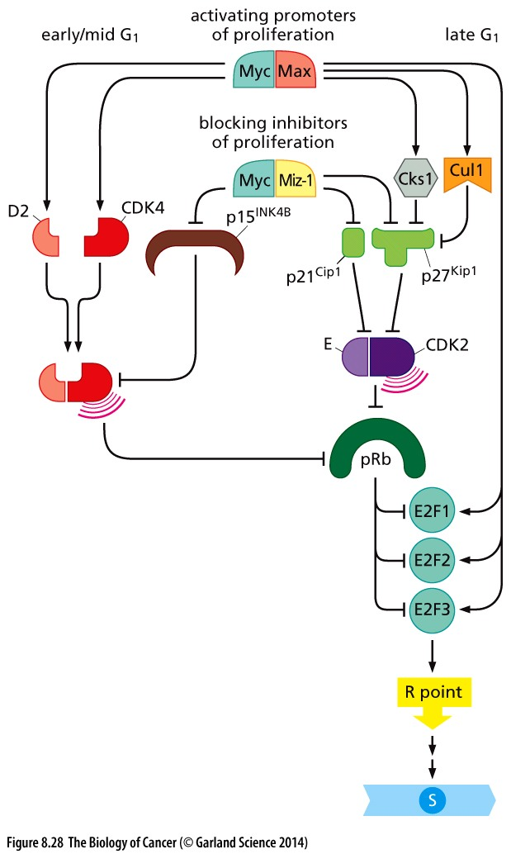
Figure 8.28 Actions of Myc on the cell
cycle clock
The Myc protein, acting with its Max partner (top), is able to modulate the actions of a number of positive and negative regulators of cell cycle advance. For example, the Myc–Max heterodimer is able to induce expression of the growth-promoting proteins cyclin D2 and CDK4 (left), which can promote advance through early G1. At the same time, by increasing the expression of Cul1 and Cks1 (which are responsible for degrading the p27Kip1 CDK inhibitor, upper right; see Figure 8.37B) as well as E2Fs 1, 2, and 3 (right, below), Myc favors advance into S phase. In addition, Myc, acting with its Miz-1 partner, is able to repress expression of the p15INK4B, p21Cip1, and p27Kip1 CDK inhibitors; once again, effects are felt both in early/ mid and in late G1.
Notes:
Myc is one of the strongest oncogene, it can affect cell cycle in multiple ways

Slide 62
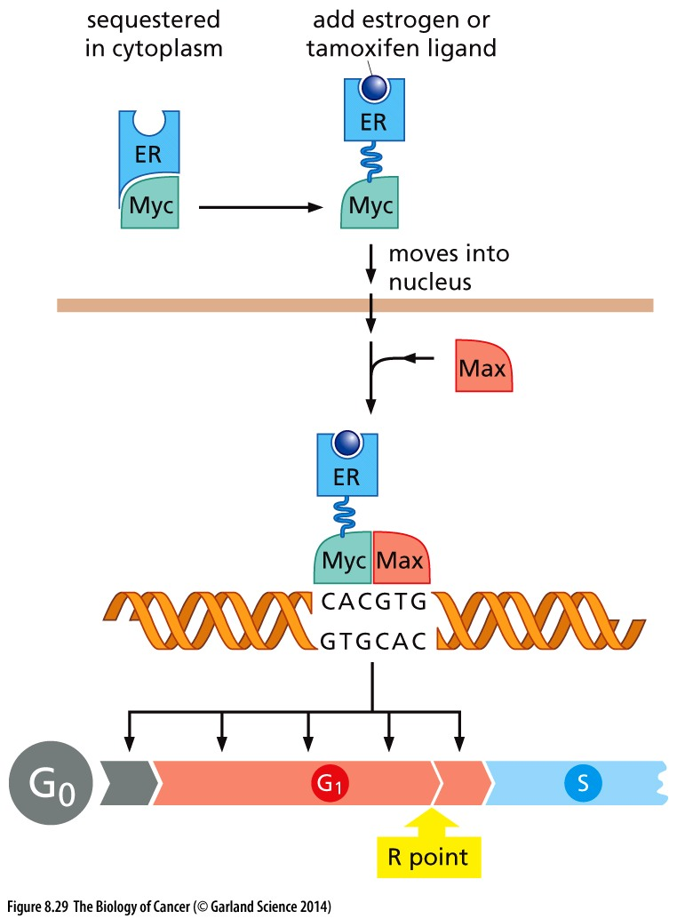
Figure 8.29 Powers of the Myc oncoprotein
The wide-ranging effects of the Myc protein are illustrated by an experiment in which the Myc protein has been fused to the estrogen receptor (ER) protein (blue). In the absence of ER ligands, such as estrogen or tamoxifen, the Myc–ER protein is trapped in the cytoplasm (through association with
heat shock proteins, not shown). When estrogen or tamoxifen ligands are added to cells, the Myc–ER protein migrates into the nucleus, associates with Max, and activates Myc target genes within minutes. Such activation, when induced in serum-starved cells in the G0 phase, enables them to enter the active cell cycle and advance all the way through G1 into the S phase, indicating that Myc can act at multiple points in G0 and G1 to drive cell cycle progression.

Slide 63
8.10 TGF-β prevents phosphorylation of pRb and thereby blocks cell cycle progression

Slide 64
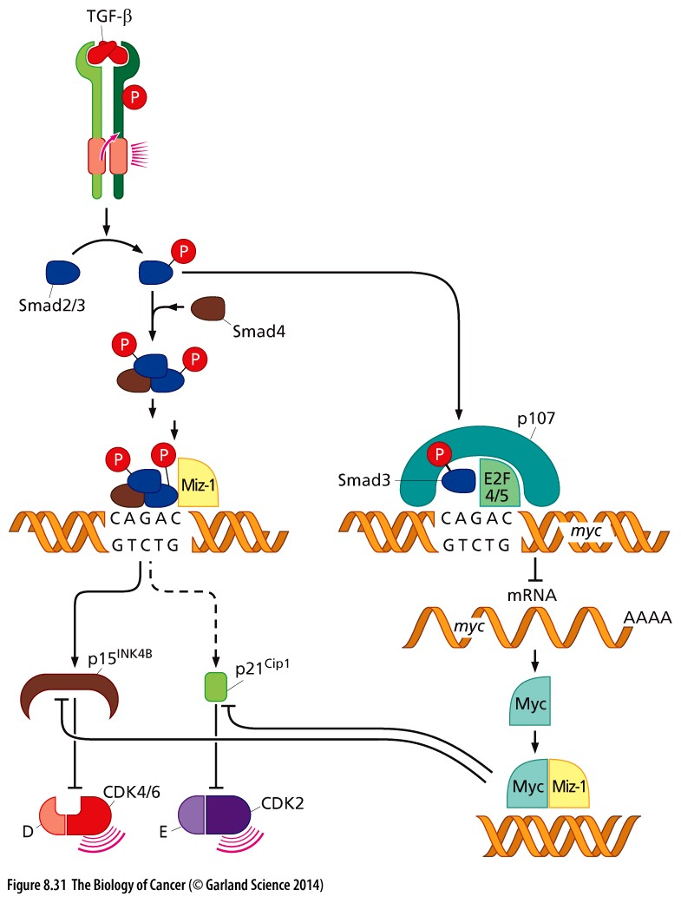
Figure 8.31 Countervailing actions of
TGF-β and Myc
TGF-β, acting through its receptor, causes phosphorylation of several Smad proteins. Two molecules of phosphorylated Smad2/3 then form a heterotrimeric complex with Smad4, and the resulting complex then migrates to the nucleus, where it teams up with Miz- 1 to induce expression of the p15INK4B and p21Cip1 CDK inhibitors. Myc, for its part, is capable of teaming up with Miz-1 to repress expression of these CDK inhibitors. However, this action of Myc can be blocked by TGF-β, which dispatches Smad3 to form a complex with E2F4 or E2F5 plus p107 (pRb’s cousin; right) that represses expression of the myc gene, thereby causing Myc levels to collapse. This ensures that TGF-β succeeds in inducing expression of the two CDK inhibitors—p15INK4B and p21Cip1—and thereby shuts down cell cycle progression in the early/mid G1 phase of the cell cycle.
Notes:
具体信号通路细节仅供参考

Slide 65
8.11 pRb function and the controls of differentiation are closely linked
Notes:
细胞分化与肿瘤关系密切

Slide 66
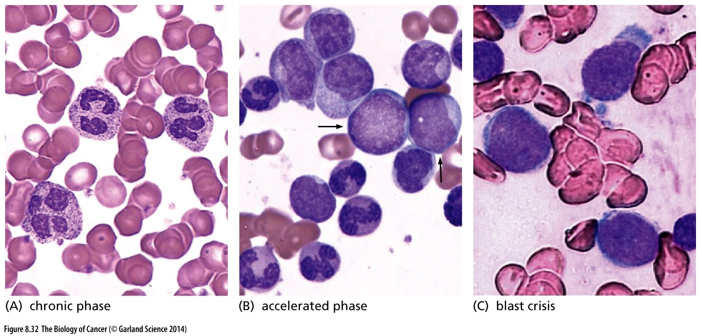
Figure 8.32 Disease progression and dedifferentiation
(A) The disease of chronic myelogenous leukemia (CML) leads to the accumulation in the blood of elevated numbers of cells that are almost fully differentiated neutrophils. The pink cells are erythrocytes. (B) After several years, when the chronic phase of the disease progresses to an “accelerated” phase, these more differentiated neutrophils are increasingly replaced by less differentiated blast cells (arrows). (C) Ultimately, this accelerated phase progresses to “blast crisis,” when the peripheral blood carries large numbers of undifferentiated blast cells.
Notes:
白血病的一个特征，细胞分化受阻。细胞分化程度越低，病情发展越晚期

Slide 67
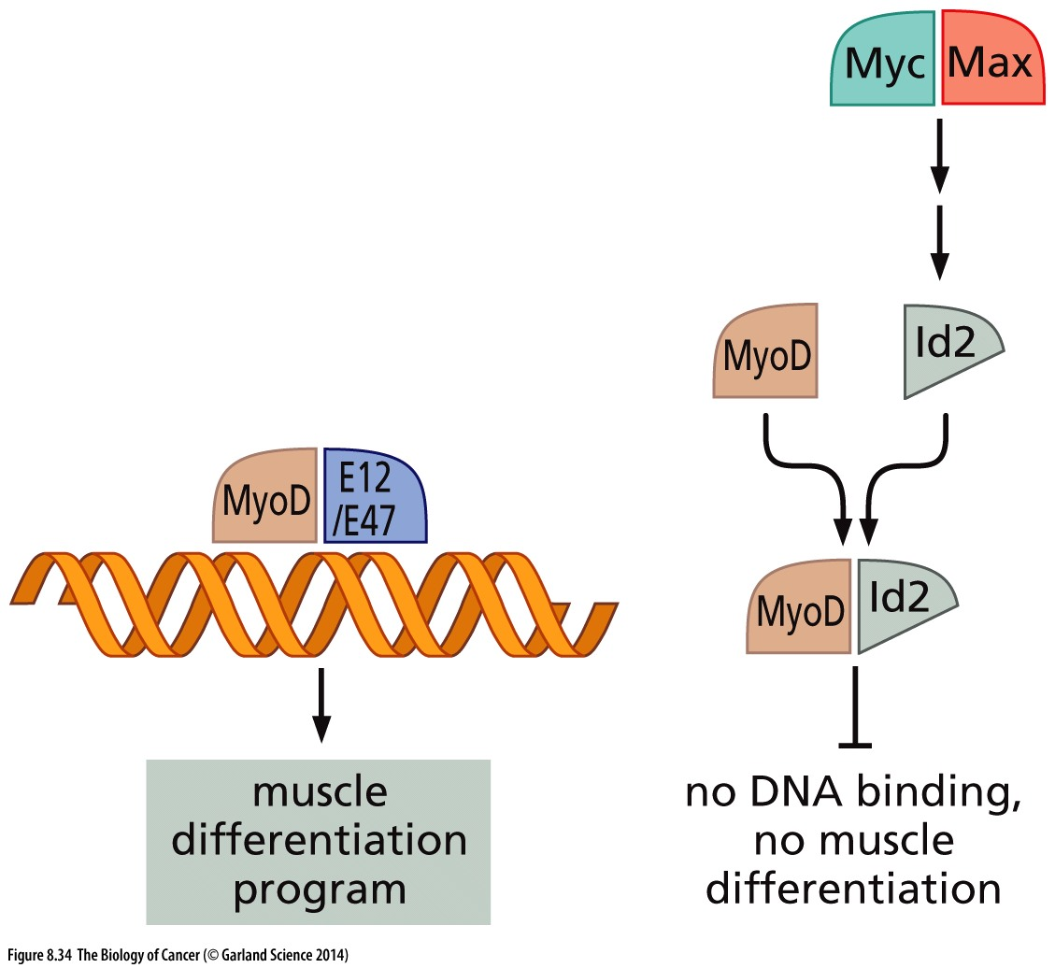
Figure 8.34 Id transcription factors and inhibition of differentiation
Lineage-specific bHLH transcription factors, such as MyoD , form heterodimers with widely expressed E12 or E47 bHLH partners (blue). The resulting heterodimeric transcription factors orchestrate differentiation programs in a variety of tissues, including muscle (left). The formation of these functional heterodimeric transcription factor complexes can, however, be blocked by Id proteins (light gray), which form heterodimers with the lineage-specific bHLH proteins, thereby preventing association of the latter with E12 or E47. Because the Id proteins lack a DNA-binding domain, they act as natural “dominant-negative” inhibitors of the lineage-specific bHLH proteins. Expression of certain Id proteins, such as the Id2 shown here, can be induced by Myc (or N-myc) acting with its partner Max (top right); this helps to explain the observed ability of the Myc oncoprotein to block differentiation of various cell types.
Notes:
Myc调控细胞分化的一个分子机制，仅供参考

Slide 68
8.12 Control of pRb function is perturbed in most if not all human cancers

Slide 69
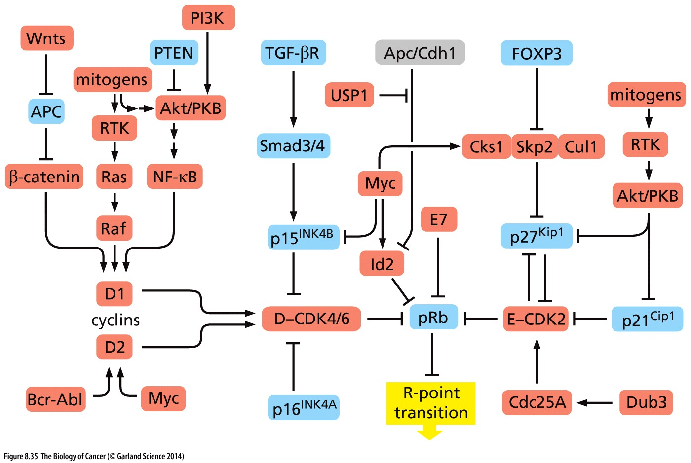
Figure 8.35 Perturbation of the R-point transition in human tumors
Elements that favor advance through the R point are drawn in red, while those that undertake to block this advance are shown in blue. Proteins whose expression levels or activities are not known to change during the process of transformation are shown in gray.
Notes:
归纳总结，外界信号如何影响R-point transition可关注 WNT/b-actin, P13K/PTEN/AKT pathways

Slide 70
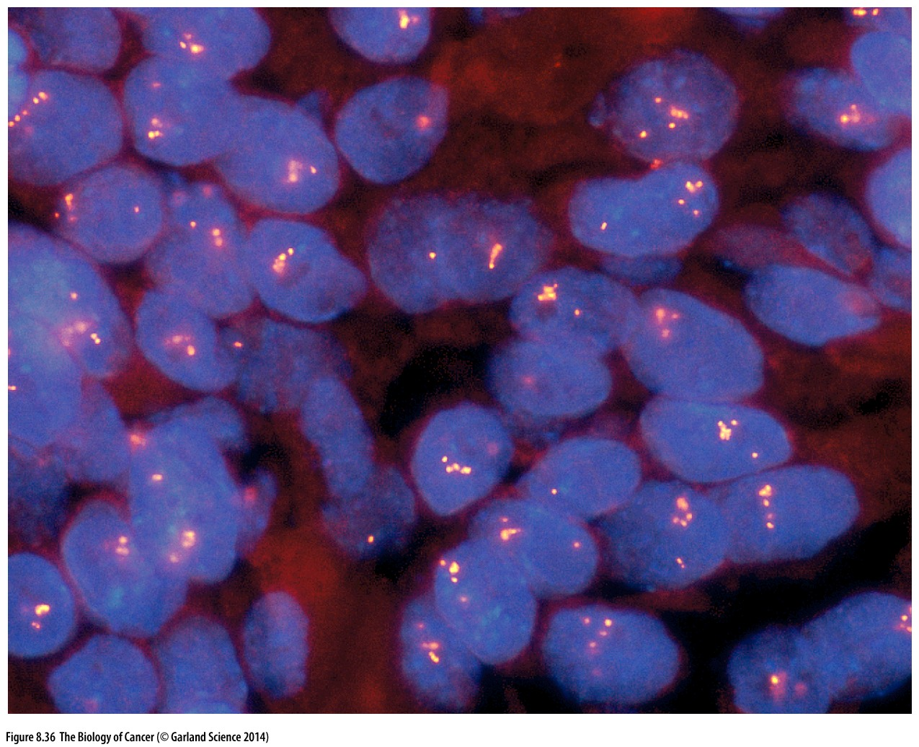
Figure 8.36 Amplification of the cyclin D1 gene
The use of fluorescent in situ hybridization (FISH) makes it possible to detect the copy number of specific genes in histological sections.

Slide 71
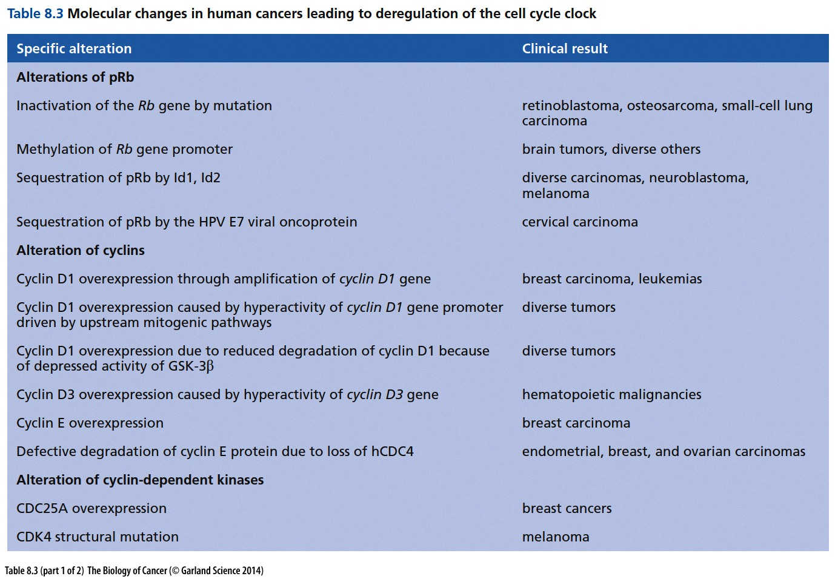

Slide 72
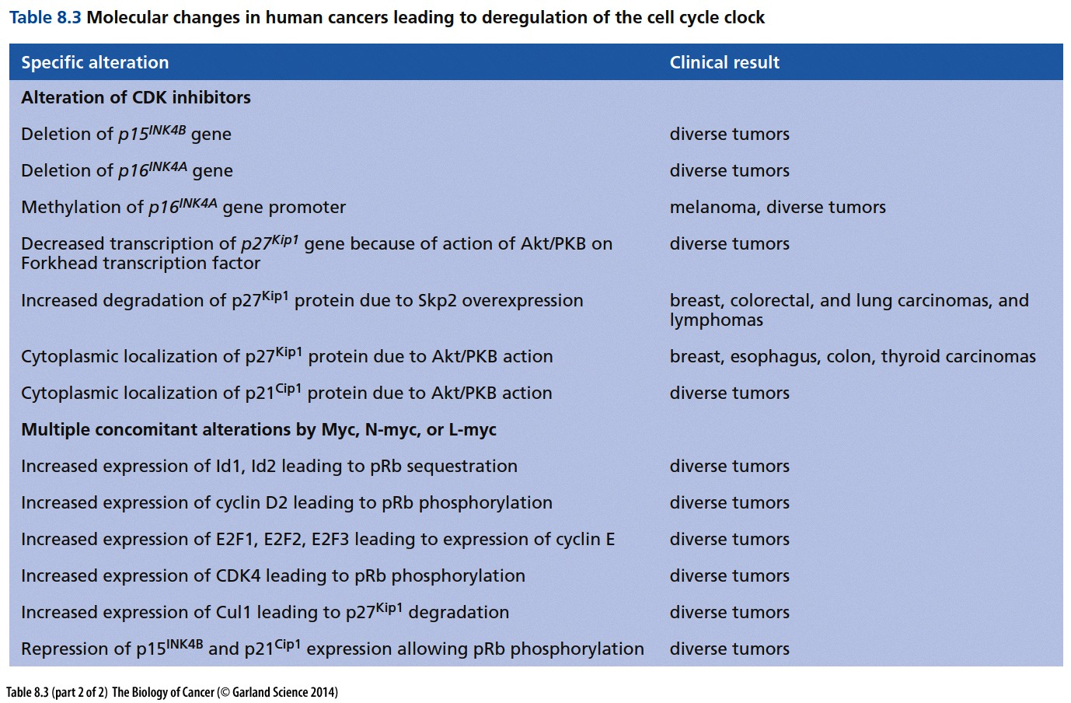

Slide 73


Slide 74

Figure 8.38 Cyclin E and breast cancer progression
(A) This Kaplan–Meier plot presents the clinical progression of disease in women with stage III breast cancer. Plotted is the fraction of patients (ordinate) who had not died from their disease at the indicated times after initial diagnosis (abscissa). (B) During normal mitosis, bipolar spindles are observed (left). However, in aggressive breast cancers, low–molecular-weight forms of cyclin E accumulate in the cytoplasm of the associated carcinoma cells, where they drive the formation of multiple extra centrosomes and resulting multipolar spindles; eight are visible here (right). This leads, in turn, to karyotypic chaos and the acceleration of tumor progression.

Slide 75
Complexities in cell cycle regulation
Cell type specific regulation
Sidebar 8.1 Embryonic stem (ES) cells show highly autonomous behavior
The pRb pathway and the cell cycle clock machinery described in this chapter appear to be operative in one form or another in virtually all types of adult cells, but not in early embryonic cells, including their cultured derivatives, embryonic stem (ES) cells.(P281)
Cell cycle regulators are always encoded by a family of genes
RB, E2F, cyclin, CDK …
Notes:
仅供参考

Slide 76
思考题
1，简述Rb蛋白参与细胞周期调控的分子机制。
2，简述细胞周期检查点（Cell cycle checkpoint）的类型和各自功能。
3，简述Myc蛋白促进细胞增殖的具体分子机制。
4，细胞通过细胞周期中的Restriction checkpoint之后一般不能逆转，简述这种不可逆的实现机制。

